Slide 1
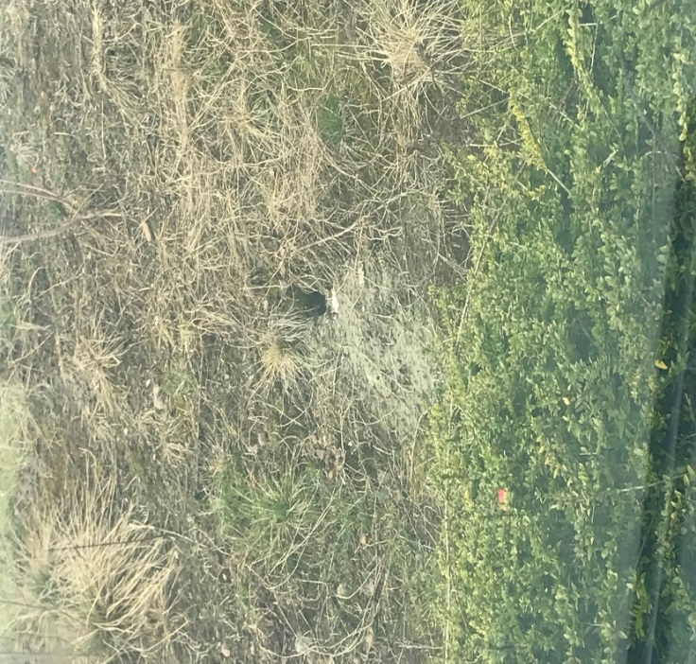
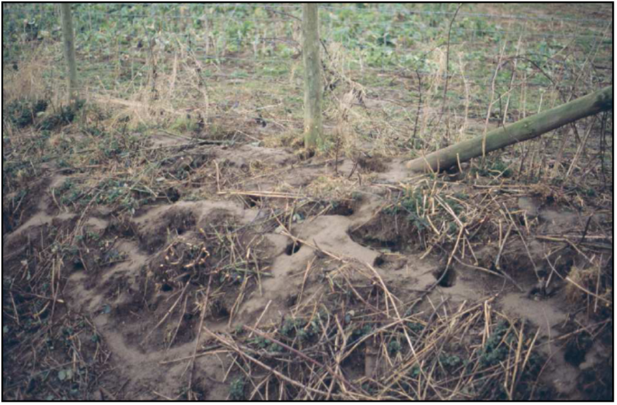
Direct Bait Application in Burrows
Justification and Mitigation Measures
CRRU UK
A training resource for:
Continuing Professional Development
Notes:
Firstly, remember to ‘read the label’ as not all rodenticides are authorized for burrow baiting.
For those that are, careful justification is needed prior to application, as well as appropriate risk mitigation measures taken.
This presentation will provide users with up-to-date information about appropriate justification and mitigation measures regarding direct bait application in burrows a.k.a. ‘burrow baiting’

Slide 2
Rodents and Risks to Human and Animal Health
Rodent infestations should be removed as quickly and effectively as possible due to the risks to public health
Uncontrolled rat populations cause damage, contamination and spread rodent-borne diseases
Burrow baiting aims to reduce / eliminate rodent neophobic behavior towards standard control apparatus e.g. bait stations
Notes:
We are all aware of the significant risk to public health created by rodents and measures should always be taken to minimize the risk in an effective way, carried out in a manner which is as safe and responsible as possible. For example, rodents can spread leptospirosis as well as many other pathogens.
Standard control measures involve bait stations or boxes which can initiate neophobia adding to the expected treatment time frame.
Battersby, S.A. (2015). Rodents as Carriers of Disease. Chapter 4 in: Rodent Pests and their Control (A. P. Buckle and R. H. Smith eds.). CAB International, Wallingford, Oxon, UK. pp 81-100.
DEFRA (2018). Rats: Control of Rats with Rodenticides - A Complete Guide to Best Practice. Department for Food and Rural Affairs. Available from: http://adlib.everysite.co.uk/adlib/defra/content.aspx?id=000HK277ZX.0B4M93RRD547JA. Date accessed: 16.01.18.

Slide 3
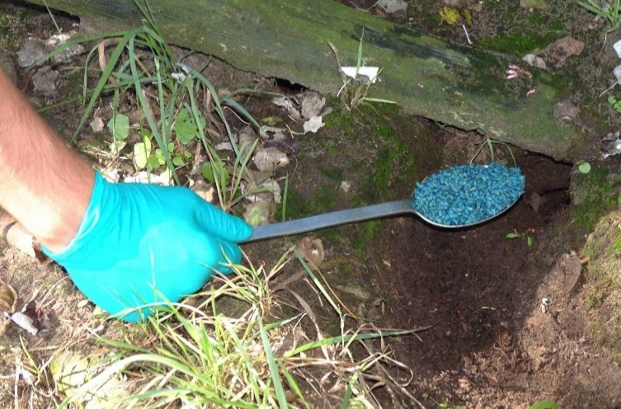
Burrow Baiting – why?
Burrow baiting is a technique used by professionals: trained and competent users
To reduce / eliminate neophobia to bait containers
Avoidance of a new bait container lasts far longer than avoidance of new food
DEFRA funded research backs this up, with the conclusion -
“Tamper-resistant containers baited with immovable block baits are appropriate if baits are inspected infrequently, but the evidence (presented in this review) suggests that relatively little rodent control will be achieved”
Notes:
Widely known in the UK pest control industry, burrow baiting brings the rodenticide to the rodent, as opposed to the expectation that the rodent will actively consume rodenticide contained within tamper-resistant bait boxes.
Neophobia (fear of new things) is one of the most challenging of all the Norway rat (Rattus norvegicus) behavioural traits. This is exhibited towards the equipment containing the bait, such as the tamper resistant boxes.
Neophobia is the exceptional wariness of unfamiliar food, or familiar food in unfamiliar places
Burrow baiting can bypass the rat’s neophobic response towards tamper resistant bait stations, thus shortening bait uptake time.
DEFRA (2018). Rats: Control of Rats with Rodenticides - A Complete Guide to Best Practice. Department for Food and Rural Affairs. Available from: http://adlib.everysite.co.uk/adlib/defra/content.aspx?id=000HK277ZX.0B4M93RRD547JA. Date accessed: 16.01.18.
Quy R.J. (2011) Review of the use of bait boxes during operations to control Norway rats, Rattus norvegicus – a report to CIEH. Chartered Institute of Environmental Health (CIEH), London, UK. 11 pp. Available from: http://www.urbanpestsbook.com/downloads/CIEH_Rodent_Procedures_Roger_Quy.pdf. Date accessed: 12 August 2015.
Macdonald, D.W., Fenn, M.G.P. and Gelling, M. (2015). The Natural History of Rodents: Preadpatations to Pestilence. Chapter 1 in: Rodent Pests and their control (A. P. Buckle and R. H. Smith eds.). CAB International, Wallingford, Oxon, UK. pp 1-18.

Slide 4
Burrow Baiting – why?
Advantages of burrow baiting
  Area of use
  Known area of target animal presence
  Bait placement very close to the nest
  More likely encountered and consumed
  Any reduction in treatment time has clear advantages
  Reduced impacts on non-target species
Notes:
Area of use – ‘open areas’ and ‘in and around buildings’ are generally where rat burrows are found.
We know the rodent is there (in an active burrow) and it is certainly active and will encounter the rodenticide.
Burrows are the centre of the home range of the rodent, increasing likelihood of bait consumption
So long as the bait remains in the burrow it is relatively protected from other non-target animals, such as field mice and voles, because these animals are likely to avoid places where animals that prey on them, such as rats, are active.
Reduction in the poisoned bait accessibility period means lower risk to humans, non-target species and the environment.
Quicker results will be achieved by transferring bait from containers to active rat burrows – there is a reduction in treatment time period due to a decreased neophobic response.
Studies show that using bait boxes has resulted in a 28% reduction of rat population versus burrow baiting giving a 72% reduction
Faster results and therefore reduction in the rodent population mean a reduced impact on public and animal health e.g. less likely to spread rodent-borne disease
Placing bait directly into a rat’s burrow may make feeding ‘safer’ for the occupant, but unfortunately it does not stop visitors ‘stealing’ bait particles.

Slide 5
Burrow Baiting – why?
The technique of burrow baiting is backed by Chartered Institute of Environmental Health. As a recommended application of rodenticide bait
“research has shown that hole or burrow baiting, where loose bait is applied directly into holes or burrows, can give the best results in encouraging bait uptake, resulting in quicker control.”
Notes:
*CIEH (2015). Pest control procedures in the food industry. The Chartered Institute of Environmental Health, Chadwick Court, London. October 2015. 52 pp. Available from: http://www.cieh.org/policy/pest_control_food_industry.html. Date accessed: 16.01.18.

Slide 6
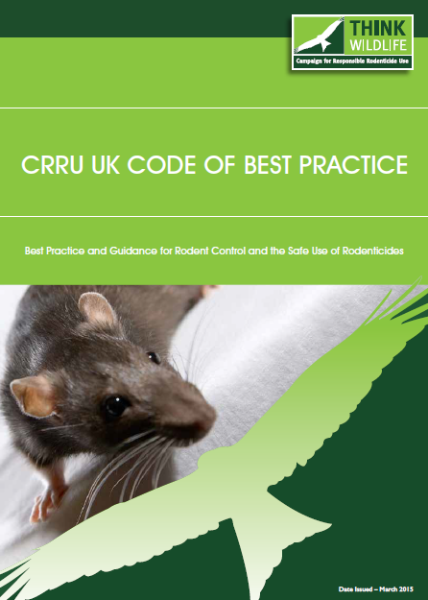
Best Practice Guidance
There is still risk
Therefore, careful environmental risk assessment is required
Regular re-assessment is essential
Carefully consider one of the greatest risks – bait ejection from the burrow
Prevention of ejection is key to protect non-targets
Burrow baiting should not normally be used when safer methods of application are practical and considered as equally effective
Notes:
Bait ejection – bait becomes available to non-target species as rats ‘kick out’ bait from their burrows
In one study, bait was ejected from 56 out of 160 treated burrows
How do we prevent bait ejection? We can cover the bait as per the standard procedure (cover the entrances of baited burrows to reduce the risks of bait being ejected and spilled or lightly block the burrow with a twist of straw or grass).
Furthermore, lessen the time any rodenticide is available to non-target species – i.e. more regular follow ups, use of wildlife cameras for monitoring and of course search for and remove rodent bodies and any spent or unconsumed bait.
When baiting burrows, treated grain is less likely to be kicked out of burrows by rats than wax blocks.
Burrow baiting will not normally be employed when safer methods of bait application, such as the use of tamper-resistant bait stations or covered and protected bait stations, are practicable and expected to be equally effective.

Slide 7
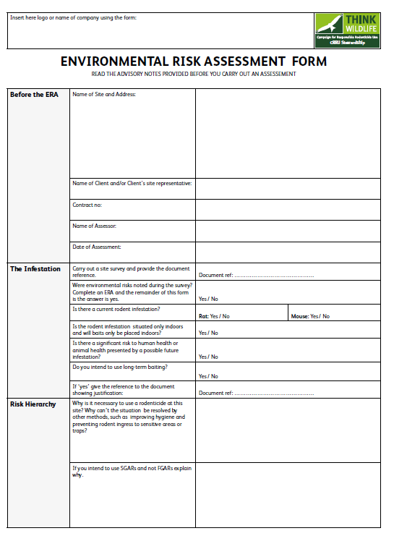
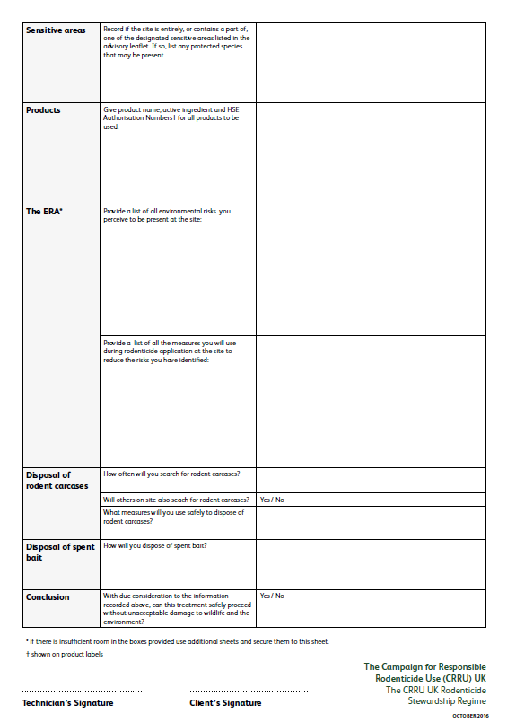
Best Practice Guidance
CRRU Code of best practice
  Follow the ‘Risk Hierarchy’
  Areas of use (check product labels)
  Site Survey
  Risk Assessment
  COSHH Assessment
  Environmental Risk Assessment
  Record findings
  Search for rodent bodies, follow up, retrieval of bait
Notes:
So to re-iterate:
Risk Hierarchy – beginning with proofing, denial of food/water, removal of harborage, progressing to trapping, (Alphachloralose – mice only), phosphine gas, FGARs, SGARs.
Picture of Environmental Risk Assessment template (from CRRU website)
CRRU (2017). CRRU Environmental Risk Assessment. The Campaign for Responsible Rodenticide Use (CRRU) UK. April 2017. 12 pp. Available at: http://www.thinkwildlife.org/downloads/. Date accessed: 16.01.18.

Slide 8
Treated Sites
Consider the area of treatment
Rat burrows are found outdoors in area where it is likely that there will be non-target animals present
In any given situation to proceed with burrow baiting the benefits must outweigh the risks, regards to human and animal health protection
The environmental risk assessment will identify the risks to non-target animals
Notes:
Most rat burrows are found outdoors where the condition of the substrate permits rats to excavate soil, and other material, to construct a burrow system. Therefore, it is likely that non-target animals will be present at many sites where burrow baiting is employed.
All who carry out burrow baiting should recognise its risks and set these against any potential benefits that may be provided by the application, in terms of human and animal health protection.
An environmental risk assessment is carried out where there is any evidence of risk to the environment and this is likely in the use of burrow baiting.
Care should be taken to identify rabbit burrows (as well as the burrows of other non-target species e.g. water voles) versus rat burrows before applying rodenticide

Slide 9
Risk Mitigation
Reduction of risk is required when rodenticide active substances are used, therefore:
Burrow baiting will not be used as a routine practice
Consider use where bait application in tamper-resistant or covered bait stations has been unsuccessful
Reasons why other methods are impractical should be documented
Where possible, prior to treatment any bystanders should be informed
Notes:
Bystanders – any other person potentially in the treated area i.e. labelling may be required.

Slide 10
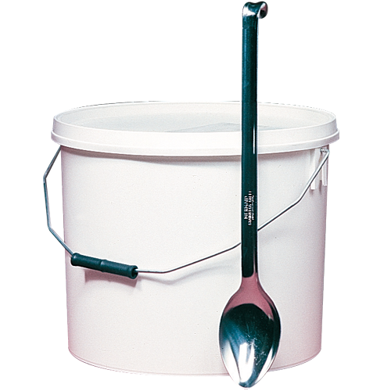
Risk Mitigation
As with other external use of rodenticide, an environmental risk assessment will be conducted
Burrow baiting will be kept to a necessary minimum
Introduce bait into the burrow as deeply as possible
Deep vertical burrows are preferable as bait ejection is much less likely when compared with shallow burrows running horizontally
Notes:
Deep baiting should be carried out with a long handled spoon or other suitable implement.
Note that baiting buckets should be labeled with a copy of the rodenticide product label.

Slide 11
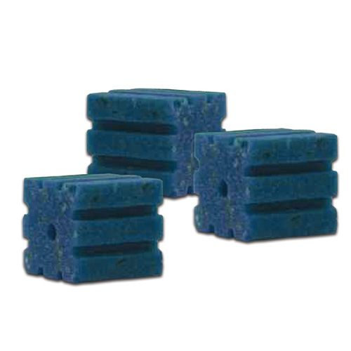
Risk Mitigation
Treat only the active burrows
Block bait use – fasten on robust wire secured into the substrate
Treated burrows will be clearly marked or recorded.
Lightly block baited burrows
Regular inspection of the treated burrows is essential
Check, preferably in the early morning for ejected bait
Notes:
Lightly block burrows - use hay/straw/grass, or where practicable corrugated sheets, wooden boards or similar materials from the surrounding area) and inspect the following day to determine which burrows are active
Identify active burrows also by smooth edges and lack of cobwebs
Avoid overfilling or blocking the entrance with heavy objects as the burrow may be abandoned before any bait is eaten.
Where bait is placed in areas of public access it is now a regulatory requirement that areas treated must be marked during the treatment period and a notice explaining the risk of primary and secondary poisoning must be made available alongside the baits.
Place baits directly into active burrows, especially in areas where the public has restricted access, such as islands on a lake. Loose grain, pelleted or sachet / pack formulations may be suitable for such purposes. Cover all treated holes, and regularly monitor for evidence of bait consumption, spillage or disturbance.
When re-inspecting baited burrows try to do this in the early morning
The reason for marking / recording treated burrows is to allow them to be easily found and inspected during revisits.
Record all of the treatment process details.

Slide 12
Risk Mitigation
Inspection frequency should be determined by the attending technician in charge.
In some situations daily visits may be required
End of treatment: re-visit and make all reasonable efforts to recover and dispose of any unconsumed baits in a safe manner
Perform post-treatment clearance and proofing
Notes:
This is useful for traceability and also accountability – keep records of visits. The responsible party should make all efforts to ensure the treatment is as safe as possible and carried out in a responsible manner.
Sites where burrow baiting is used should be visited more frequently than those where secure bait boxes are employed because of the greater likelihood of bait coming out of the burrows and being taken by non-target animals.
CRRU Code of Best Practice: In order to deter rodent infestations, sites should be cleared of all debris, rubbish, old machinery and equipment, unwanted stores of straw and hay, etc. Vegetation should be cleared around buildings to provide an open perimeter and immediate surroundings, so that natural predators can take rodents. If possible, areas around buildings may be laid to concrete, or other hard surfaces, to prevent rodent burrowing.

