Slide 1
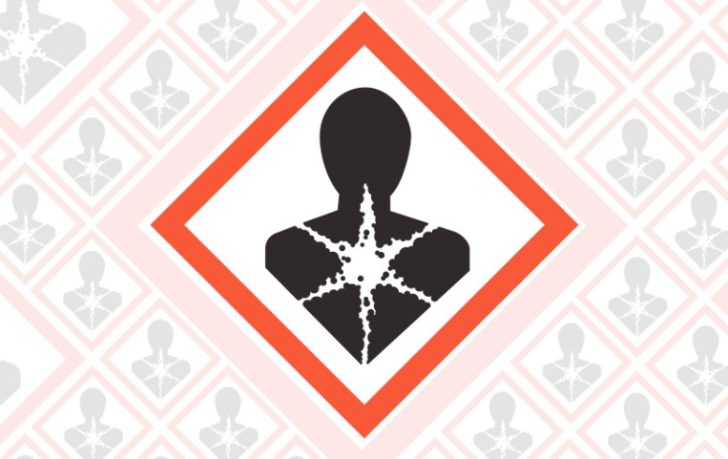
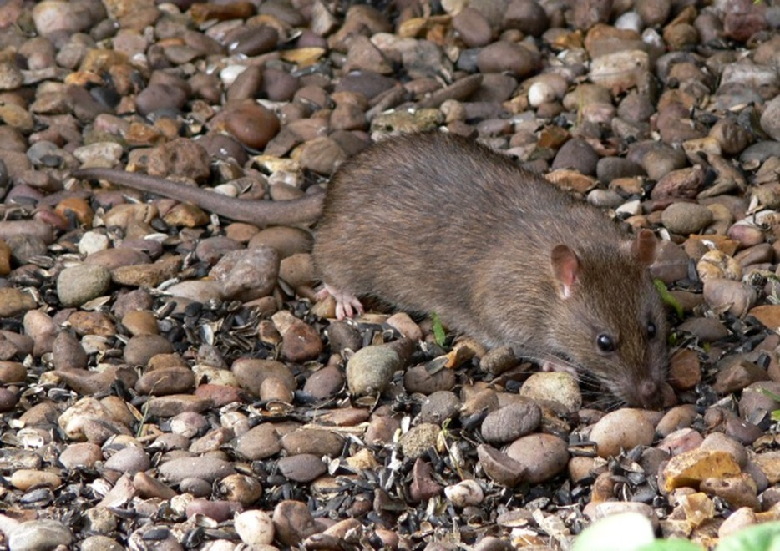
Changes to the Classification of Anticoagulants and Permitted Pack Sizes
CRRU UK
A training resource for:
Continuing Professional Development

Slide 2
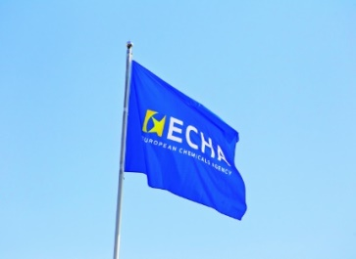
Anticoagulant classification change
The European Chemicals Agency’s Committee for Risk Assessment (ECHA’s RAC ) reviewed anticoagulants
Anticoagulants re-classified as:
  Toxic to Reproduction (if containing ≥ 0.003% active substance)
  Specific organ toxicity on repeated exposure
Applies to all anticoagulants: brodifacoum, bromadiolone, chlorophacinone, coumatetralyl, difenacoum, difethialone, flocoumafen and warfarin.
Notes:
A review by the European Chemicals Agency’s Committee for Risk Assessment (ECHA’s RAC) has resulted in a change in classification for the eight anticoagulant rodenticide active substances (brodifacoum, bromadiolone, chlorophacinone, coumatetralyl, difenacoum, difethialone, flocoumafen and warfarin).
The active substances will have the following additional classifications:
Toxic for reproduction, with a concentration limit of 0.003% (30 ppm).
Specific Target Organ Toxicity on Repeated Exposure.

Slide 3

Rodenticide classification – when?
From 1st March 2018 all product containing ≥ 0.003% active substance must carry the new classification on label:
Old labelled product must be used by 28th Aug 2018
Danger: May damage the unborn child. *May cause damage to organs (blood) through prolonged or repeated exposure (*phrase may or may not be applied depending on the active substance).
Notes:
From the 1st of March, 2018, any anticoagulant rodenticide product offered for sale, containing one of the active substances with a concentration of 0.003% (or 30 parts per million (ppm)) or greater, must be labelled in accordance with the new classification. There is a further 6 months use-up period.

Slide 4
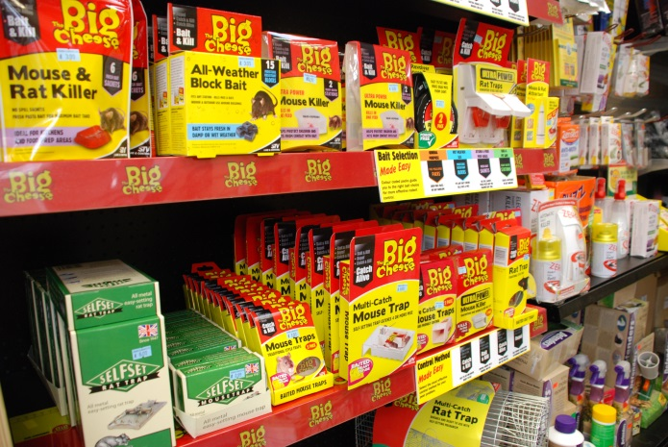
No amateur use of rodenticides classified as Toxic to Reproduction
Amateur use withdrawn unless containing <0.003% (30 ppm) active substance
30 ppm is the Specific Concentration Limit
It is a concentration of 0.003%
X
Notes:
Amateur use will be withdrawn on 1 March 2018, for products containing ≥30 ppm (0.003%).
Most anticoagulant rodenticides available in the UK contain more than 30 ppm of the active substance, although some manufacturers are introducing lower concentrated products onto the market.

Slide 5
Professional use of rodenticides classified as Toxic to Reproduction
Professional use of SGARs (and FGARs) at a concentration of ≥0.003% can continue
Many SGAR products available contain 0.005% (50 ppm) of active substance
…what about employee & client reactions?
Is <0.003% preferable? Will not be classified as toxic to reproduction…
Notes:
Professionals can continue to use products labelled as Toxic to reproduction. There may be some concern amongst clients when such products are used in their vicinity. It is important to note that the new classification is *hazard based and does not take **risk into account. Provided that the product is used according to the label instructions, the risk to the operator and their clients is minimised.
*a hazard is anything that may cause harm (HSE definition).
**risk is the chance or somebody being harmed by the hazard (HSE definition).

Slide 6
Impacts on the pest control industry
Potential reduction in efficacy of SGARs at <0.003%?
Two lines of products, at (usually) 0.005% and <0.003%? – professionals must make a reasoned choice
Note: some rodenticides already at 0.0025%
Notes:
There is currently a high level of speculation in the industry and media regarding the efficacy of products containing less than 0.003% (30 ppm) active substance.
Before a product can be marketed, data have to be provided to the regulatory authority to support the label claims for efficacy.

Slide 7
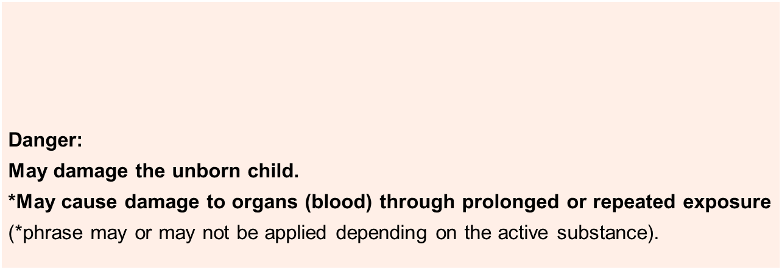
Summary points – Toxic to Reproduction
A European Committee has reclassified rodenticides
≥ 0.003% =
Some recipients of pest control services may be concerned
Minimise any risk by using the product according to the label instructions
Lower strength products (<0.003%) are not reclassified

Slide 8
Pack sizes: professionals
Minimum pack size: 3kg
Smaller packs may be allowed for some products.
Maximum pack size: 10kg (loose grain baits only)
Pack size restrictions will be implemented Q1 – Q3 2018
Notes:
Pack sizes for professional use will be restricted to a minimum of 3kg and a maximum of 10kg.
These pack size restrictions have been agreed across the EU:
the minimum size is restricted to reduce the likelihood of smaller packs being sold in the amateur market. Smaller packs can be proposed & authorised if accompanied by a robust justification based on the Biocides Products Regulation.
the maximum size is relevant only to loose bait and potentially can be increased if it can be demonstrated that personal protective equipment (PPE) e.g. respiratory protective equipment, is not required when decanting from larger packs.
The restrictions on pack size will be implemented following renewal of products authorisations in Q1/Q2 2018.

Slide 9
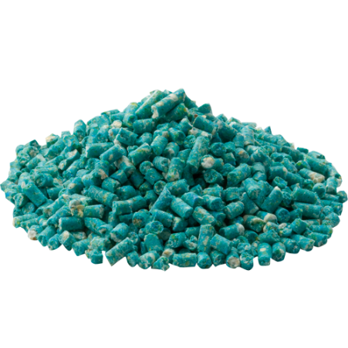
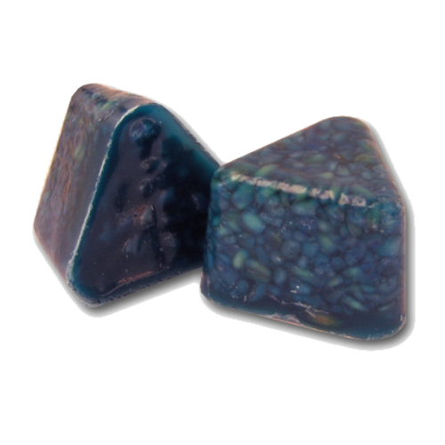
Pack sizes: non-professionals
(mice only)
Grain, pellet, paste: max 50g
Loose baits (e.g. grains, pellets) must be supplied in sachets (or similar)
Wax block: max 100g

Slide 10
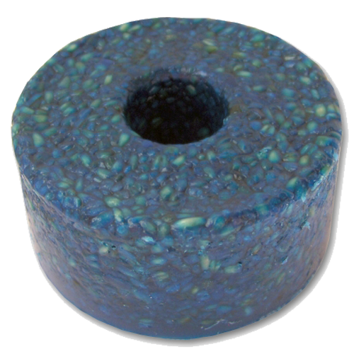
Pack sizes: non-professionals
(rats only, or mice and rats)
Grain, pellet, paste: max 150g
Loose baits (e.g. grains, pellets) must be supplied in sachets (or similar)
Wax block: max 300g

Slide 11
Summary points – Pack Sizes
A European committee has implemented new rules on pack sizes. The main changes are:
  There are minimum pack sizes for many professional products. This is to deter the purchase of these products by non-professionals due to their high cost
  There are maximum pack sizes for non-professionals. This is to reduce the quantities of rodenticides available to untrained users
  Presently, the regulations do not prevent the purchase of several packs by non-professionals because this is very difficult to implement. High price of non-professional products will serve to deter multiple purchases

