Slide 1
The Campaign for Responsible Rodenticide Use UK
(CRRU UK)
Stewardship update – 2025
Strengthening measures and Code of Best Practice update
CRRU UK
A training resource for:
Continuing Professional Development
© Copyright 2025
This presentation may be used free of charge in any format or medium provided that it is reproduced accurately and not used
in a misleading context. The material must be acknowledged as CRRU UK copyright and the title of the document specified.
Notes:
Reading material for trainers and delegates is https://www.thinkwildlife.org/code-of-best-practice/
Trainers must familiarise themselves with the Q&A details here, for each user group: https://www.thinkwildlife.org/training-certification/
Follow CRRU UK press releases https://www.thinkwildlife.org/press-release/
Trainers to be familiar with the resistance section of the CRRU UK Code of Best Practice.
Tell delegates that further advice is available here https://www.rrag.uk/
And that resistance maps are found here https://rrac.info/

Slide 2
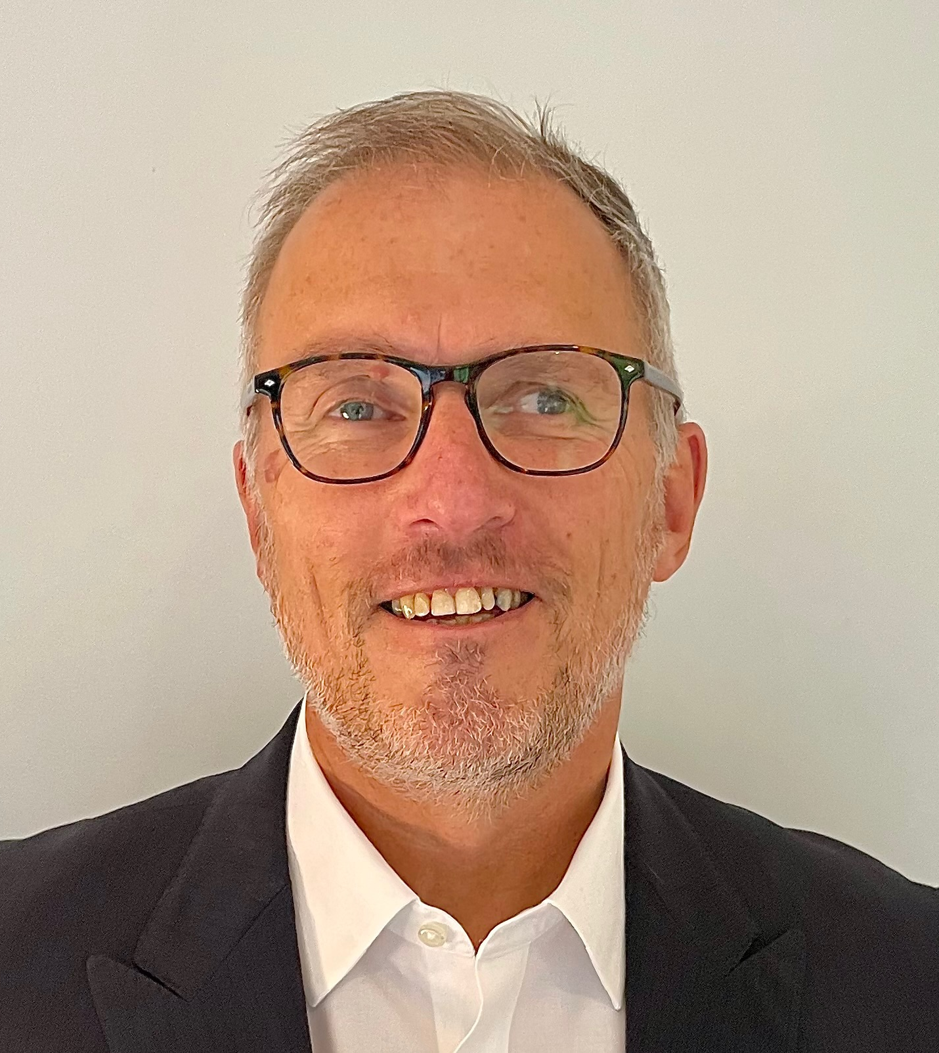
CRRU UK Chairman
Nigel Cheeseright
Succeeding Dr Alan Buckle who retired after 20 years as Chair of CRRU UK
23 years working in chemical manufacturing and supply chains
11 years in pest control with Rentokil Initial
Involved with CRRU UK activities since 2010 as Director / Member Company
Chair of CRRU UK – 1st May 2024
© Copyright 2025
This presentation may be used free of charge in any format or medium provided that it is reproduced accurately and not used
in a misleading context. The material must be acknowledged as CRRU UK copyright and the title of the document specified.

Slide 3
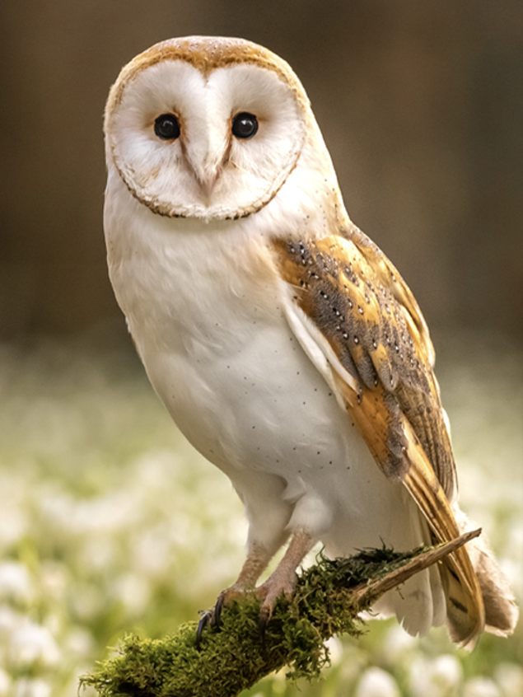
Why Stewardship?
The reason we are here
Second Generation Anticoagulant Rodenticides (SGARs) (and other rodenticides) possess certain hazardous characteristics
These characteristics mean that if safer, equally effective alternative rodenticides existed, SGARs would not be approved for use
In order to authorize SGARs, Government required that an industry led stewardship programme was implemented to monitor the supply, purchase, use, disposal and environmental impact of the products
In other words, rodenticide stewardship is essential to make sure that the products remain available to professional users
In the meantime, it is CRRU UK’s role to coordinate this process and to ensure we can collectively meet the UK Stewardship obligations
© Copyright 2025
This presentation may be used free of charge in any format or medium provided that it is reproduced accurately and not used
in a misleading context. The material must be acknowledged as CRRU UK copyright and the title of the document specified.

Slide 4
What is CRRU UK?
Our role
CRRU UK is an organization responsible for coordinating rodenticide product stewardship in the United Kingdom.
CRRU UK ensures the responsible and effective use of ALL rodenticides
through the promotion of best practice supply and use practices and training of users to protect wildlife.
http://www.thinkwildlife.org
© Copyright 2025
This presentation may be used free of charge in any format or medium provided that it is reproduced accurately and not used
in a misleading context. The material must be acknowledged as CRRU UK copyright and the title of the document specified.

Slide 5
Who is involved in CRRU UK?
Cross Industry Collaboration
Reporting to the Government Oversight Group or GOG¹
Funded by subscriptions from all Anticoagulant Rodenticide authorisation holders
Involvement of a diverse range of stakeholders
Oversee the Stewardship programme and set the requirements for Stewardship to meet
13 companies - 2024
12 companies - 2025
Pest Control
Farming representatives in England, Scotland, Wales and NI
Gamekeeping
Wildlife / Conservation
Training
Government / Public Health
¹ GOG consists of HSE, Natural England, Nature Scotland, Public Health, SASA, UKCEH
© Copyright 2025
This presentation may be used free of charge in any format or medium provided that it is reproduced accurately and not used
in a misleading context. The material must be acknowledged as CRRU UK copyright and the title of the document specified.

Slide 6
CRRU UK Organisation
GOVERNMENT OVERSIGHT GROUP
CRRU UK CHAIR
CRRU UK BOARD
CRRU UK SUPPORT
CRRU UK TASK FORCE
Regulatory
Best Practice
Point of Sale
Training & Certification
Monitoring
Comms
Harmonise and simplify product labels with manufacturers
Ensure that products with same uses and use patterns have common label language.
Provide Stewardship Monitoring Data to HSE
Set the standard for POS checks
Ensure that POS checks are implemented
Devise & oversee the independent POS audit process.
Set the standards for distributors & centralised purchasing
Report to government on:
Resistance
SGAR Residues
KAP Survey
Develop Best Practice Code of Best Practice (CoBP)
Ensure that users comply with CoBP
Work with Farm Assurance Schemes and align them with CoBP (prior to 2026)
Govern the CRRU UK framework for training and certification
Define the minimum standards for proof of competence
Set compliance guidelines for CPD schemes
Communicate to external agencies
Sector specific communications
Produce original material to promote the CRRU UK programme.
© Copyright 2025
This presentation may be used free of charge in any format or medium provided that it is reproduced accurately and not used
in a misleading context. The material must be acknowledged as CRRU UK copyright and the title of the document specified.

Slide 7
How do we track Stewardship?
Tracking performance
Training data
Training uptake
Farm Assurance Scheme membership
Best practice guidance
POS audit performance
Monitoring
User awareness (KAP)
Barn owl liver residues
Rodenticide resistance
© Copyright 2025
This presentation may be used free of charge in any format or medium provided that it is reproduced accurately and not used
in a misleading context. The material must be acknowledged as CRRU UK copyright and the title of the document specified.

Slide 8
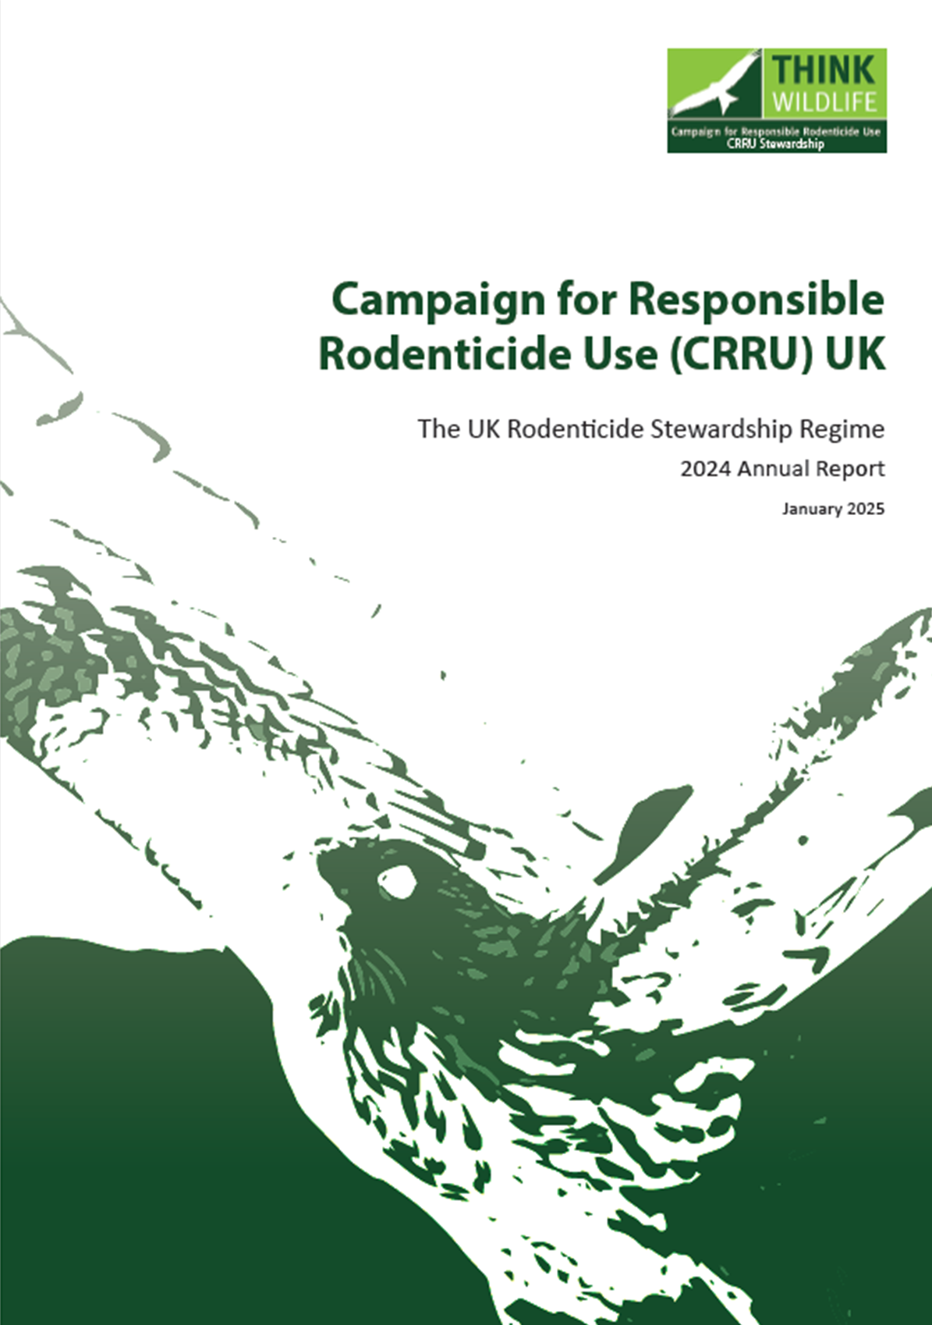
How do we track Stewardship?
Tracking performance
Training data
Training uptake
Farm Assurance Scheme membership
Best practice guidance
POS audit performance
Monitoring
User awareness (KAP)
Barn owl liver residues
Rodenticide resistance
© Copyright 2025
This presentation may be used free of charge in any format or medium provided that it is reproduced accurately and not used
in a misleading context. The material must be acknowledged as CRRU UK copyright and the title of the document specified.
Notes:
The highlighted point (in red) is explained here:
https://www.thinkwildlife.org/latest-rodenticide-surveillance-finds-stubborn-barn-owl-residues/
https://www.thinkwildlife.org/ending-use-of-second-generation-anticoagulant-rodenticides-bromadiolone-and-difenacoum-away-from-buildings/

Slide 9
CRRU UK
Have Implemented Two Stewardship Strengthening Measures
© Copyright 2025
This presentation may be used free of charge in any format or medium provided that it is reproduced accurately and not used
in a misleading context. The material must be acknowledged as CRRU UK copyright and the title of the document specified.

Slide 10
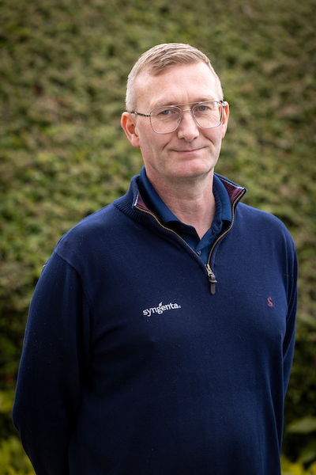
CRRU Monitoring Lead
Richard Moseley
Almost 30 years in the industry
Key Account & Business Development Manager, Syngenta
Head of CRRU Monitoring Work Group
NPTA Board of Directors
© Copyright 2025
This presentation may be used free of charge in any format or medium provided that it is reproduced accurately and not used
in a misleading context. The material must be acknowledged as CRRU UK copyright and the title of the document specified.

Slide 11
Strengthening measure 1
Open area use – no anticoagulant use
Legal Authorisations removed from all SGARs 4th July 2024 for ‘open area’ and ‘waste dump’ applications
This has impacted products containing bromadiolone & difenacoum
A voluntary move instigated by CRRU UK and approval holders aimed to reduce SGAR contamination
Products purchased before 4th July 2024 could be used until 31st December 2024
After 31st December 2024 it became illegal to use any SGAR in an ‘open area’ or on a ‘waste dump’
© Copyright 2025
This presentation may be used free of charge in any format or medium provided that it is reproduced accurately and not used
in a misleading context. The material must be acknowledged as CRRU UK copyright and the title of the document specified.

Slide 12
Strengthening measure 1
Open area use – no anticoagulant use
What are examples of open areas? Away from buildings
public parks and gardens
railways (embankments, cuttings etc.)
canals
the banks of natural water courses
reservoirs
footpaths
bridleways
cycle paths
allotments
airports/air-fields
field margins
hedgerows / feed hoppers
© Copyright 2025
This presentation may be used free of charge in any format or medium provided that it is reproduced accurately and not used
in a misleading context. The material must be acknowledged as CRRU UK copyright and the title of the document specified.
Notes:
Only a cholecalciferol product has authorisation for open areas and waste dumps

Slide 13
Strengthening measure 1
Waste dumps – no anticoagulant use
‘Waste dumps’ are also now considered to be a separate use scenario
Only baits may be applied at waste dumps that permit such use on the label
This scenario covers control of rats and disposal of rats in waste dumps and landfills where the exposure is assumed to be higher than that described in the open area scenario
For example, waste dumps do not include municipal waste management facilities (e.g. recycling centres) where treatment is undertaken to prevent risks to public health in urban settings
© Copyright 2025
This presentation may be used free of charge in any format or medium provided that it is reproduced accurately and not used
in a misleading context. The material must be acknowledged as CRRU UK copyright and the title of the document specified.
Notes:
Only a cholecalciferol product has authorisation for open areas and waste dumps

Slide 14
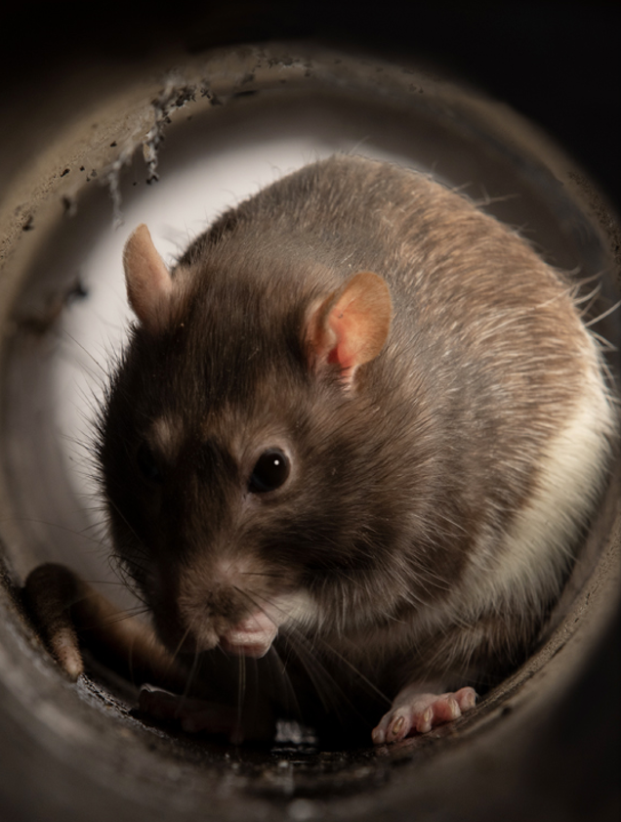
Open area use
In and around buildings
‘In and around buildings’ is understood to include the entire building that is the subject of the treatment, or those areas of it that are or may become infested. It also includes the infested area around the building that needs to be treated in order to deal with the rodents that are potentially moving into the building, causing damage to the building or property, or present a risk to the health of people or other animals.
The term ‘outdoors – around buildings’ is now the officially authorised use and is seen on some product labels and in regulatory documents (CRRU UK Code of Best Practice July 2024).
© Copyright 2025
This presentation may be used free of charge in any format or medium provided that it is reproduced accurately and not used
in a misleading context. The material must be acknowledged as CRRU UK copyright and the title of the document specified.

Slide 15
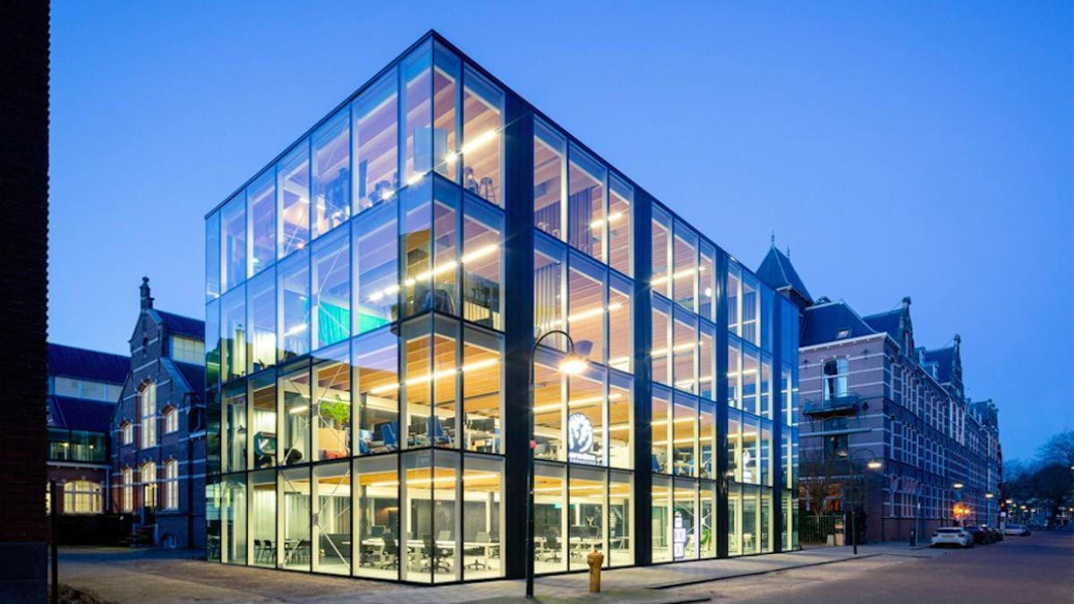
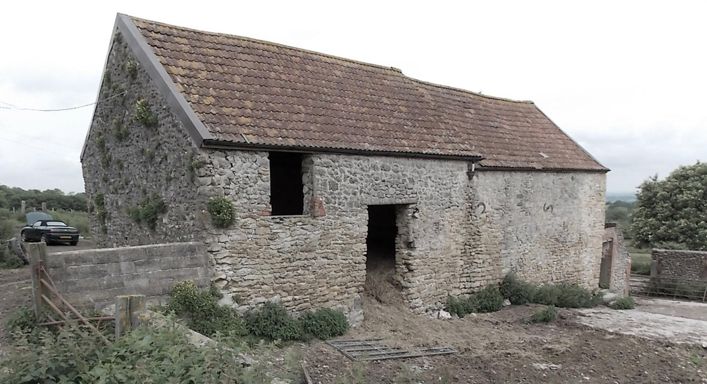
Open area use
What is a building?
For the purposes of rodent pest management, a building is typically considered to be a permanent fixed structure forming an enclosure and providing protection from the elements. Buildings can be used to exclude certain non-target animals and birds from taking baits placed inside. They are usually erected on foundations, largely enclosed and constructed from wood, brick, concrete or metal. Temporary structures or structures that can easily be moved would not generally be considered to be buildings.
(CRRU UK Code of Best Practice July 2024)
© Copyright 2025
This presentation may be used free of charge in any format or medium provided that it is reproduced accurately and not used
in a misleading context. The material must be acknowledged as CRRU UK copyright and the title of the document specified.

Slide 16
Open area use
What is a building?
Given the diverse use areas for these products we understand that this may not directly address all scenarios raised by members
Cases where temporary structures are erected or moved into open areas to justify continued baiting will not be considered acceptable
Recognising that these products are only for use by trained professionals, reasonable judgement will be necessary
(CRRU UK Code of Best Practice July 2024)
© Copyright 2025
This presentation may be used free of charge in any format or medium provided that it is reproduced accurately and not used
in a misleading context. The material must be acknowledged as CRRU UK copyright and the title of the document specified.

Slide 17
Open area use
What is a building? Questions to ask
Is it typically considered to be a permanent fixed structure?
Does it form an enclosure?
Does it provide protection from the elements?
Can it be used to exclude certain non-target species and birds from taking baits placed inside?
Is it usually erected on foundations?
It is largely enclosed?
Is it constructed from wood, brick, concrete or metal?
© Copyright 2025
This presentation may be used free of charge in any format or medium provided that it is reproduced accurately and not used
in a misleading context. The material must be acknowledged as CRRU UK copyright and the title of the document specified.

Slide 18
Strengthening Measure 2
Training & Certification
Requirements
© Copyright 2025
This presentation may be used free of charge in any format or medium provided that it is reproduced accurately and not used
in a misleading context. The material must be acknowledged as CRRU UK copyright and the title of the document specified.
Notes:
Trainers must familiarise themselves with the Q&A details here, for each user group: https://www.thinkwildlife.org/training-certification/

Slide 19
CRRU UK code of best practice
Summary of changes covered in the 2024 version
© Copyright 2025
This presentation may be used free of charge in any format or medium provided that it is reproduced accurately and not used
in a misleading context. The material must be acknowledged as CRRU UK copyright and the title of the document specified.
Notes:
The presenter should introduce this slide as capturing the outstanding update points, noting that the following have already been covered.
Nigel Cheeseright noted as the Chair of CRRU UK
Availability of SGAR baits for use away from buildings
Updated wording reference in and around buildings
Definition of a building for the purpose of rodent pest management
Definition of waste dumps

Slide 20
First generation anticoagulants
Availability in the UK
The first-generation anticoagulants are less acutely toxic to some species…
and less persistent in animal tissues than the second generation compounds
However, there are currently no rodenticide baits available for use in the UK that contain first-generation anticoagulants as their active ingredients
(only a contact foam)
© Copyright 2025
This presentation may be used free of charge in any format or medium provided that it is reproduced accurately and not used
in a misleading context. The material must be acknowledged as CRRU UK copyright and the title of the document specified.

Slide 21
Cholecalciferol update
Clarification on use patterns
Cholecalciferol baits may be used against Norway rats Rattus norvegicus, black rats Rattus rattus and house mice Mus musculus
This includes resistant strains
Cholecalciferol is not persistent in the environment
Therefore it may be assumed to present a lower risk of secondary poisoning
However, it is not free from risks to non-targets
It is, like many rodenticides, acutely toxic to some species
© Copyright 2025
This presentation may be used free of charge in any format or medium provided that it is reproduced accurately and not used
in a misleading context. The material must be acknowledged as CRRU UK copyright and the title of the document specified.

Slide 22
Cholecalciferol update
Clarification on use patterns
Some baits containing cholecalciferol are permitted for use against wood mice
(Apodemus sylvaticus)
However, they are not authorised for use against the closely related yellow-necked mouse
(Apodemus flavicollis)
Ensure that this species is not inadvertently exposed to cholecalciferol baits
Some products containing cholecalciferol are authorised for use in ‘open areas’
and at ‘waste dumps’
© Copyright 2025
This presentation may be used free of charge in any format or medium provided that it is reproduced accurately and not used
in a misleading context. The material must be acknowledged as CRRU UK copyright and the title of the document specified.

Slide 23
Lower strength baits
Additional wording
Some anticoagulant rodenticide active substances are included in products at different concentrations, some higher than others
The principle of the risk hierarchy and the rules of COSHH indicate that baits of lower strength of a given active substance should be used if there is a choice and it is anticipated they will be fully effective
The recommendations of the Rodenticide Resistance Action Group (RRAG) should also be followed
That is that ‘lower-strength’ baits of a given active substance should be used at sites where it is known, or reasonably expected, that no anticoagulant resistance occurs…
…and ‘higher strength’ baits should be employed where resistance is known, or reasonably expected, to be present.”
© Copyright 2025
This presentation may be used free of charge in any format or medium provided that it is reproduced accurately and not used
in a misleading context. The material must be acknowledged as CRRU UK copyright and the title of the document specified.

Slide 24
Glue boards
Glue traps / sticky boards
Glue boards now only approved for use in certain areas
Although the use of rodent glue boards is permitted in some parts of the UK, this method does raise concerns about humaneness
You should consider all other options before adopting this method of control and clearly justify its use for each treatment
When using rodent glue boards, the frequency of inspection and dispatch of captured animals must follow the relevant local country requirements
England: glue traps banned for amateur use - under licence for professional pest controllers
Wales: glue traps banned for use
Scotland: glue traps proposed to be banned for use and sale
© Copyright 2025
This presentation may be used free of charge in any format or medium provided that it is reproduced accurately and not used
in a misleading context. The material must be acknowledged as CRRU UK copyright and the title of the document specified.

Slide 25
Covered and protected bait points
Using existing materials
The default requirement in the application of rodenticide baits is the use of tamper-resistant bait stations to reduce the exposure of non-target animals
However, it is recognised that the use of this equipment may either delay the consumption of bait by some individual rodents that are reluctant to enter bait boxes or, perhaps, prevent it altogether
Therefore, where manufacturers have been granted appropriate product authorisations, it is permissible to use other methods to make bait safe
Generally, the expectation is that any ‘covered and protected bait points’ should be at least as secure from non-targets as a tamper-resistant bait box
Protect and secure bait points using existing materials
© Copyright 2025
This presentation may be used free of charge in any format or medium provided that it is reproduced accurately and not used
in a misleading context. The material must be acknowledged as CRRU UK copyright and the title of the document specified.

Slide 26
Updated resistance guidance
Rodenticide Resistance Action Group (RRAG)
© Copyright 2025
This presentation may be used free of charge in any format or medium provided that it is reproduced accurately and not used
in a misleading context. The material must be acknowledged as CRRU UK copyright and the title of the document specified.
Notes:
Trainers / presenters to be familiar with the resistance section of the CRRU UK Code of Best Practice.
Tell delegates that further advice is available here https://www.rrag.uk/
And that resistance maps are found here https://rrac.info/

Slide 27
CRRU Training & Certification WG Leader
Dr Matthew Davies
20 years in the industry
Head of technical department, Killgerm Chemicals Ltd
Head of CRRU UK T&C WG since 2015
© Copyright 2025
This presentation may be used free of charge in any format or medium provided that it is reproduced accurately and not used
in a misleading context. The material must be acknowledged as CRRU UK copyright and the title of the document specified.

Slide 28
Thank you
© Copyright 2025
This presentation may be used free of charge in any format or medium provided that it is reproduced accurately and not used
in a misleading context. The material must be acknowledged as CRRU UK copyright and the title of the document specified.

