Slide 1
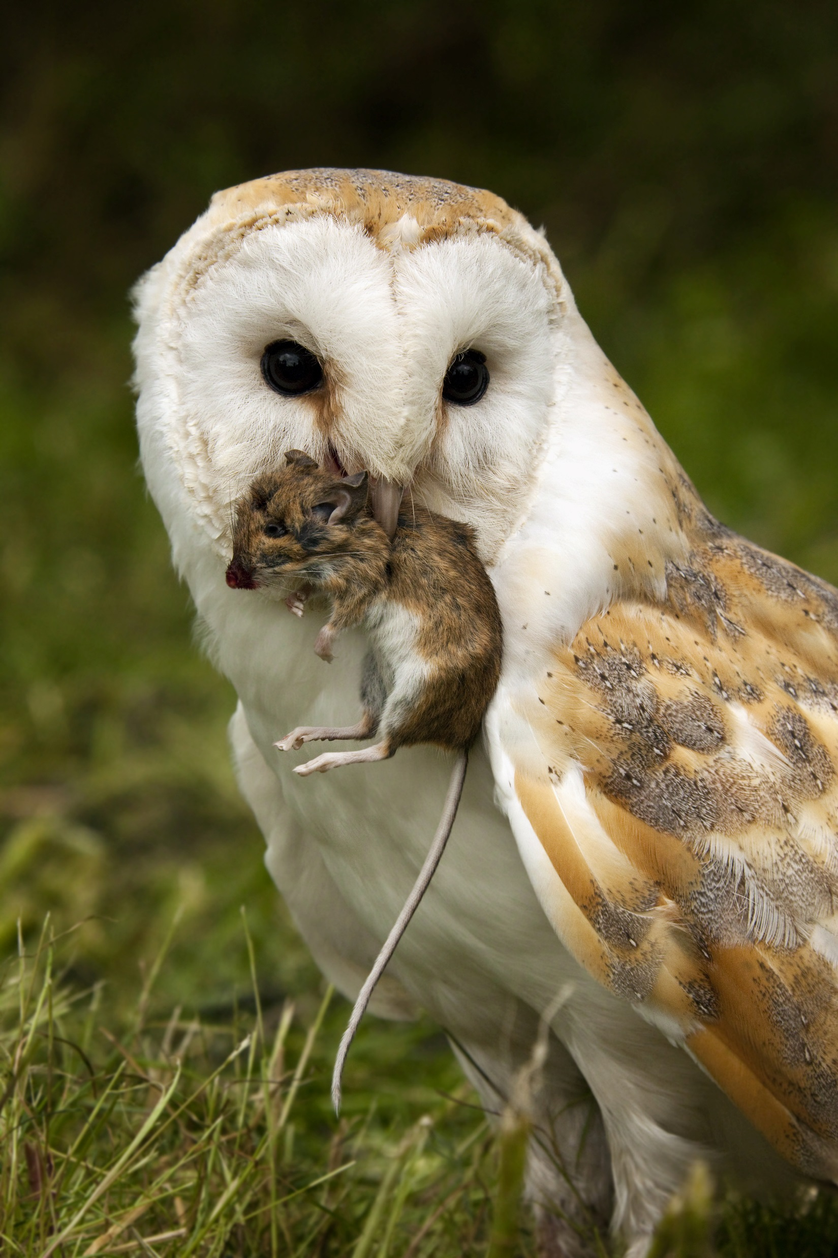
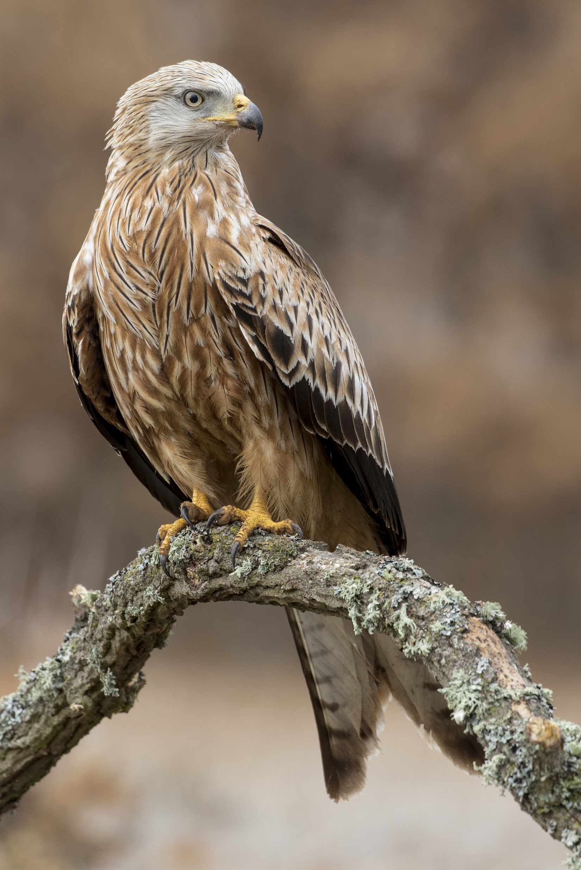
Environmental Risk Assessments
CRRU UK
A training resource for:
Continuing Professional Development
© Copyright 2018
This presentation may be used free of charge in any format or medium provided that it is reproduced accurately and not used
in a misleading context. The material must be acknowledged as CRRU UK copyright and the title of the document specified.
Notes:
The following documents should be made available:
For the students, a copy each of the CRRU Environmental Risk Assessment Guidance 2016 and a blank CRRU Environmental Risk Assessment Form 2016.
Reference will be made to the CRRU UK Code of Best Practice and Guidance for Rodent Control and the safe Use of Rodenticides 2016 and also to the CRRU Guidance on Permanent Baiting 2016. Ideally the students should have copies of these documents as well, but certainly the course presenter should have copies to show and refer to.
These are all downloadable from the CRRU website: https://www.thinkwildlife.org/downloads/
Image left: Barn owl Tyto alba with wood mouse Apodemus sylvaticus
Image right: Red kite Milvus milvus

Slide 2
INTRODUCTION

Slide 3
What is an Environmental Risk Assessment?
it is an ASSESSMENT of the RISKS that you may introduce into the local ENVIRONMENT as a result of the rodent treatment you are considering
it is just like any other Risk Assessment, but focussed mainly on non-target wildlife that might be affected by your work
all other animals – humans, pets or stock animals - should have been considered in your standard Site Risk Assessment
remember there may be risk to the aquatic environment if a rodenticide bait enters water
Notes:
Course presenters should be familiar with how to conduct a standard Risk Assessments. The ERA should follow a similar format:
Identify the HAZARDS
Assess the RISKS
Consider and implement CONTROL MEASURES to REDUCE these RISKS

Slide 4
Environmental Risk Assessments
we will focus on anticoagulant (AVK) rodenticides, though other control measures may also harm the environment
all AVK rodenticides are classified as:
  PERSISTENT (extremely persistent in the environment)
  BIOACUMMULATIVE (residues build up in animal tissues)
  TOXIC (to all birds and mammals)
so they are CANDIDATES FOR SUBSTITUTION, which means they would have been removed from the market throughout Europe had there been alternatives that are equally effective
they are reviewed every few years and may yet be removed
Notes:
Anticoaglant baits are also referred to as ‘Anti Vitamin K’ agents, due to their mode of action on the metabolism of Vitamin K – hence the abbreviation ‘AVK’
It is important to stress that the AVKs didn’t just fail the EU’s requirements, they failed spectacularly badly!

Slide 5
Environmental Risk Assessments
AVK rodenticides are therefore potential HAZARDS
  they can harm the environment, through primary and secondary poisoning
every time you use them, you pose a RISK to
  ‘non-target’ wildlife
  other environmental compartments e.g. water
you should therefore carry out an ENVIRONMENTAL RISK ASSESMENT (ERA) when you use a rodenticide where wild ‘non-targets’ may be harmed, so you can identify all available and appropriate RISK MITIGATION MEASURES

Slide 6
Environmental Risk Assessments
what is meant by ‘primary poisoning’?
  poisoning of non-target animals by eating bait
a large variety of animals, including some unexpected ones, could be affected
  small birds and animals entering bait boxes – field mice, voles, slugs, snails, sparrows, finches etc
  larger animals, such as foxes, feeding on spillages from bait points
  spillages into water courses can also affect fish and other aquatic organisms e.g. otters
Notes:
This is an opportunity to emphasise the fact that many small birds and animals can and will enter bait points, where many will eat bait if the opportunity arises.
It is an opportunity to discuss different formulations which may reduce the likelihood of non-targets eating the bait. Loose bait is more likely to be taken than block baits, for instance.
Spillages into water may provide fish with food, though AVKs are highly insoluble.

Slide 7
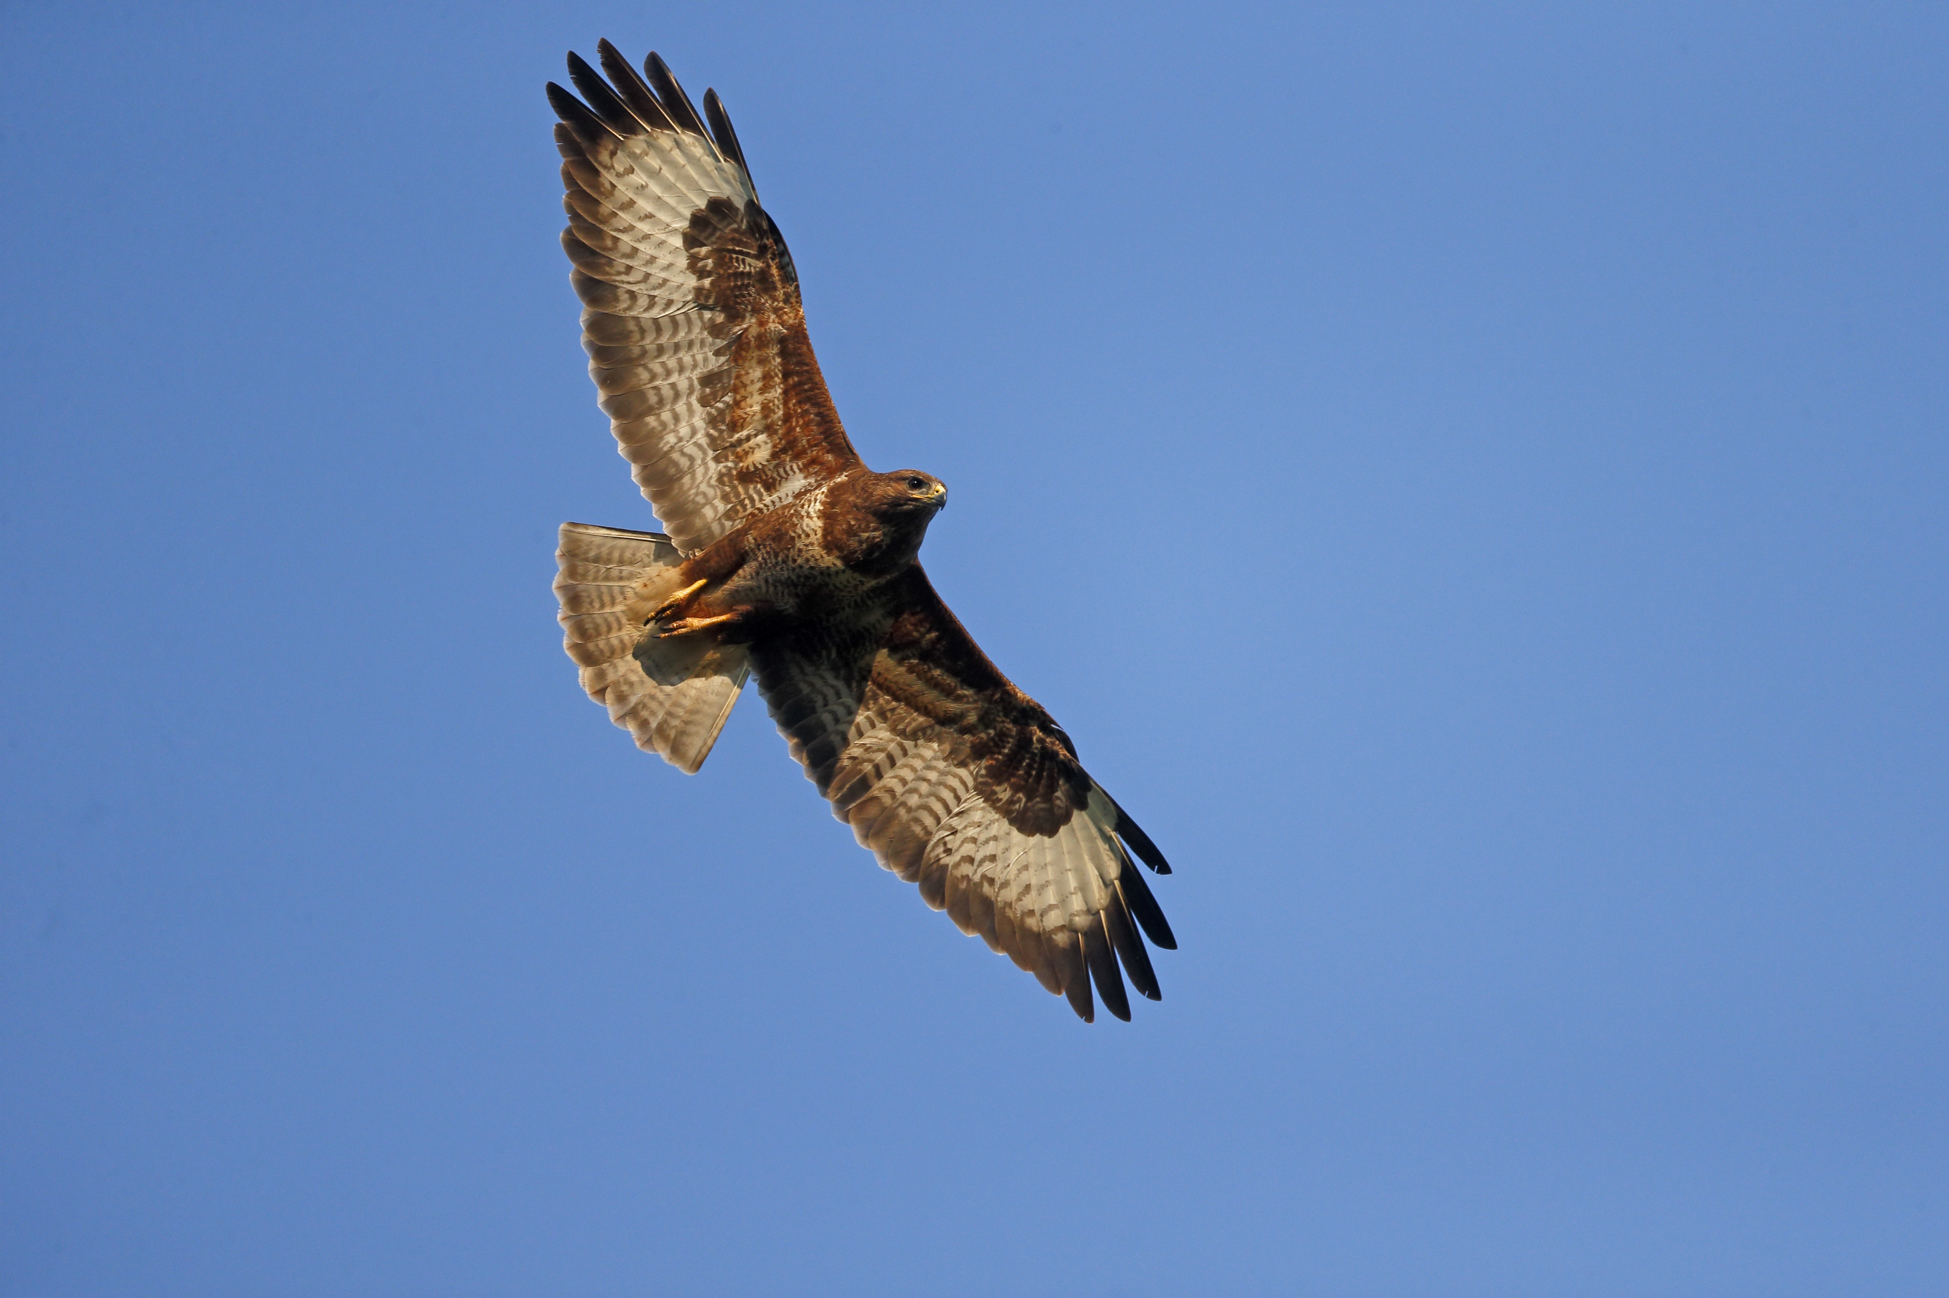
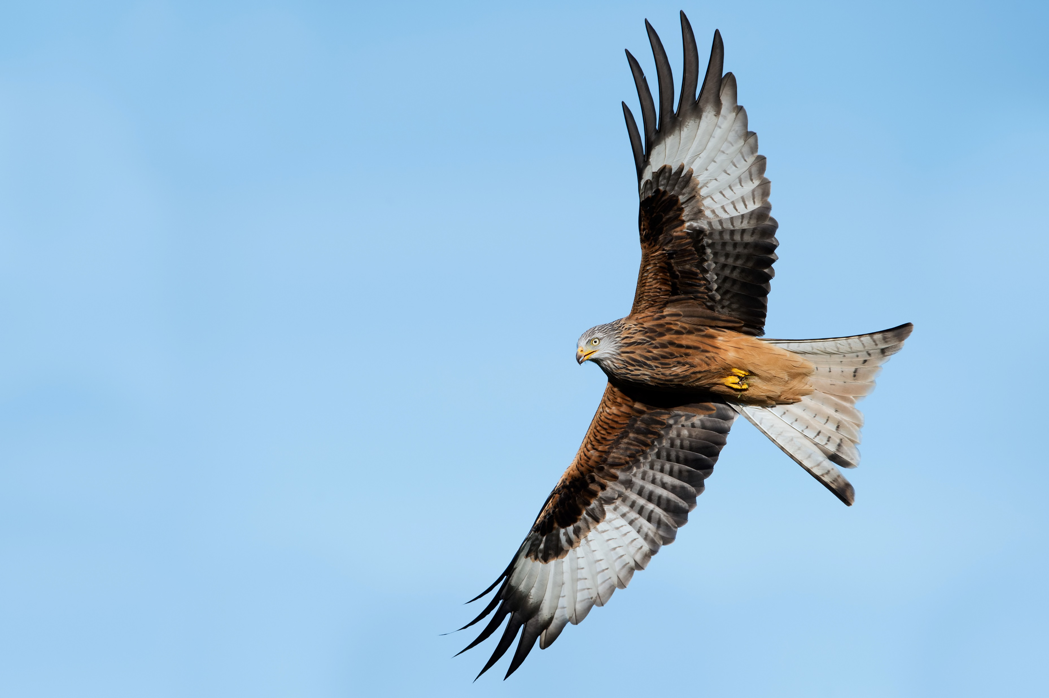
Environmental Risk Assessments
what is meant by ‘secondary poisoning’?
  poisoning of non-target animals that eat animals who have first eaten baits
these may be predators, including owls, hawks, falcons, foxes, hedgehogs and otters
may be scavengers e.g. buzzards and red kites
Notes:
An opportunity to discuss this aspect in more detail.
As AVKs are so persistent in body tissues, they bioaccumulate in food chains.
Slugs, snails and insects can eat bait, so can contaminate unexpected predators, such as hedgehogs.
Small birds entering bait stations, can then be eaten by falcons.
Otters can eat contaminated fish.
Emphasise that virtually all wild animals can become contaminated with AVK residues.
Image left: Buzzard Buteo buteo. Image right: Red kite Milvus milvus

Slide 8
Environmental Risk Assessments
the list of those ‘non-target’ wild birds and animals that could be affected by these very persistent chemicals is very extensive
tests on a very wide variety of species have shown that contamination of the environment is widespread and has been increasing for many years
that is why we must change our use of anticoagulant rodenticides

Slide 9
Environmental Risk Assessments
the RISK of contamination increases:
depending on where you place the baits
  ‘indoors only’, including sewers – LOW RISK
  ‘in and around buildings’ - HIGHER RISK
  ‘open areas’, including rubbish dumps – VERY HIGH RISK
whether in URBAN, SUBURBAN or RURAL areas
also on how long you leave them in place
some sites may also have specific potential problems which you must identify and deal with, such as water courses
Notes:
The lowest risk treatment would be a ‘one off’ indoor-only treatment for House Mice, in an urban situation.
The highest risk treatment would be an ‘open areas’ treatment for rats, in a rural setting – especially if it was a permanent baiting programme.
It might be useful to get the students to come to this conclusion themselves by asking relevant questions.

Slide 10
Why Bother?
hopefully, you do not want to endanger any wild animal on your property / client’s property
we were all doing this unwittingly for many years
now we know better
we need to show the Authorities that we can use AVK rodenticides properly – otherwise we could lose them
producing ERAs is one way of demonstrating this

Slide 11
Why Bother?
a pest controller was successfully prosecuted following a Wildlife Incident Investigation, triggered by a dead fox with AVK residues in it
they faced several charges relating to the improper use of AVK baits
one charge was “failing to produce an Environmental Risk Assessment”
this was in 2011
a legal precedent has been set
Notes:
Details of the case can be found here:
https://www.pestmagazine.co.uk/en/news/posts/2011/aug/rodent-services-east-anglia-fined-over-3-000-for-improper-rodenticide-use
It is worth pointing out that ‘legal precedents’ are extremely important in British Law.

Slide 12
Why Bother?
a bird or animal could die on any premises, at any time, with AVK residues in them
this could trigger a WILDLIFE INCIDENT INVESTIGATION, perhaps on a site for which you are responsible…
an ERA will help act as a DUE DILIGENCE DEFENCE should you become the focus of such an investigation
there are ongoing tests on ‘monitor species’ being carried out throughout the country

Slide 13
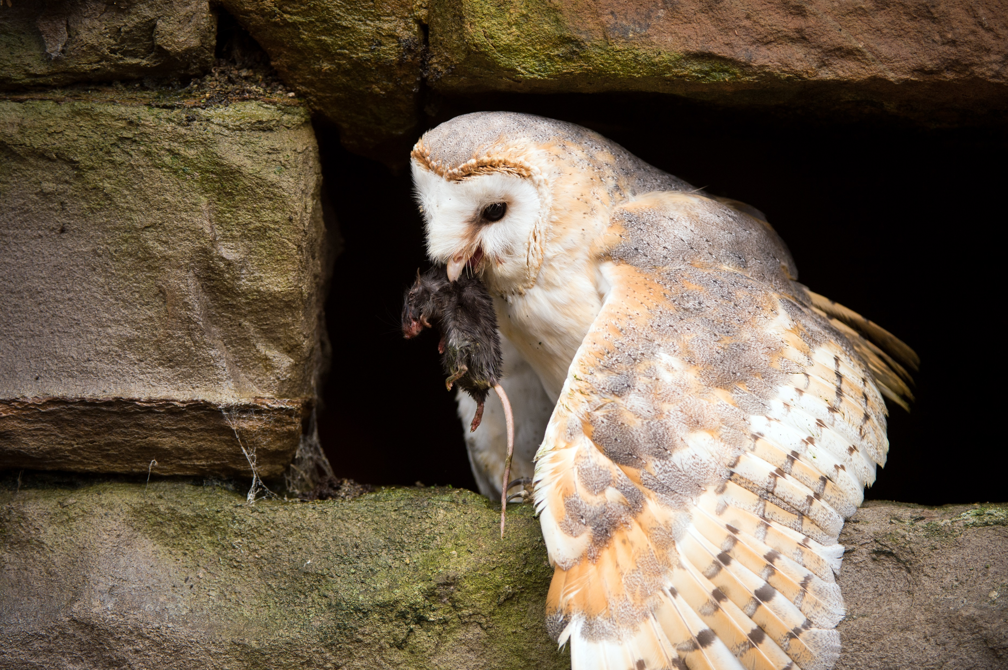
Barn Owls
Barn Owls have been monitored for AVK residues for over 30 years
the proportion that show such residues has been rising for many years, to very high levels
this proportion must fall significantly if the Rodenticide Stewardship Regime is to be judged successful
Notes:
This is an opportunity to discuss the significance of Barn Owls as a ‘monitor species’, as they are the top of their food chain, whose principal prey are small ‘non-target’ rodents, like Field Mice and voles.
Image: Barn owl Tyto alba with small rodent prey
AVK residues have been rising steadily in Barn Owls for many years, so that over 80% were contaminated in 2015. Few had sufficient AVK residues in them to cause death, but any residues indicate that AVKs are getting into the food chain.
Such high levels of contamination suggest gross misuse of AVK baits.
The HSE want to see ‘significant reductions’ in the proportion of Barn Owls showing AVK contamination. This would be a key measure of the success of the Rodenticide Stewardship Regime.
CRRU are paying for up to 100 Barn Owl bodies per year to be analysed for these residues.

Slide 14
Why Bother?
the 2016 CRRU Code of Best Practice on the Use of Rodenticides states that an ERA should be carried out
failing to have one for a site under investigation could harm your defence
in short, the Authorities expect you to have one in place at sites where your actions could harm the environment – especially with AVK baits
Notes:
The presenter should have a copy of the CRRU UK Code of Best Practice and Guidance for Rodent Control and the Safe Use of Rodenticides to hand.
It can be downloaded from here: https://www.thinkwildlife.org/downloads/

Slide 15
The CRRU UK Environmental Risk Assessment - Preparation

Slide 16
The CRRU ERA Form & Guidance Notes
Documents can be obtained on-line: https://www.thinkwildlife.org/downloads/
developed by industry experts and approved by the CRRU Board and other Industry ‘stakeholders’, including relevant Government Departments
accepted by the HSE as the ‘Industry Standard’ Environmental Risk Assessment
should be used at all sites where there is a risk to the Environment from AVK baits
Notes:
The presenter should hand out copies of the CRRU ERA Form and the CRRU Guidance Notes to students at this point.

Slide 17
Before the ERA
carry out a site survey - the starting point for any rodent treatment
  this needs to be documented
is there a significant potential RISK to the ENVIRONMENT from your proposed treatment?
  if YES, complete the ERA
  if NO, record your reasons why you consider it unnecessary
Notes:
If the decision is that no environmental risk is likely, there is no need to complete the ERA, but a record of this decision – and the reasons behind it – should be recorded in writing and put with the treatment records for that site.

Slide 18
The Site Survey
what is the EXTENT of the infestation?
what NON-TARGET animals are present?
  pets, stock animals, humans (especially vulnerable groups)
  wild animals (especially ‘protected species’)
is there a RISK to the ENVIRONMENT from AVKs?
  from PRIMARY poisoning
  from SECONDARY poisoning
  from bait entering a watercourse or water body
RECORD YOUR FINDINGS

Slide 19
The CRRU UK Environmental Risk Assessment - IMPLEMENTATION

Slide 20
The Infestation
is there a current rodent infestation, or likelihood of a future one?
  rat / mouse? (species?)
  indoors only?
  is there a significant risk to human or animal health by future infestation?
  are you planning to use ‘long term baiting?
  if yes, where is the written justification for this?
Notes:
The significance of the species question will be dealt with later.
Any ‘outdoor’ treatment with AVKs would result in a risk to the environment. Only ‘indoors only’ treatments would have a very low risk.
The significance of the risk to humans and animals is discussed later.
The significance of ‘long term baiting’ is dealt with later – it introduces the concept of this sort of treatment requiring written justification.

Slide 21
Which Species of Rodent?
AVK products used to say ‘for the control of rats and mice…’
now, all products refer to species:
  Rattus norvegicus, Rattus rattus and Mus musculus
Field mouse / Wood mouse, Apodemus sylvaticus, is not specified on any label
it is therefore now illegal to use any AVK product to control this species
Notes:
This change in the label instructions has come in over the last few months, so may not be familiar to all users.
Some, indeed may have old stock that says ‘for the control of rats and mice’.
It is an important point to make, as this affects the old ‘Standard Operating Procedures’ of many users that relied on permanent baiting around buildings.
It is important to point out that Apodemus active around the outside of buildings does not necessarily mean they will move indoors – they are principally outdoor animals.
However, they can come inside and cause problems, especially if the building is poorly proofed. Once inside, they become pests of course.

Slide 22
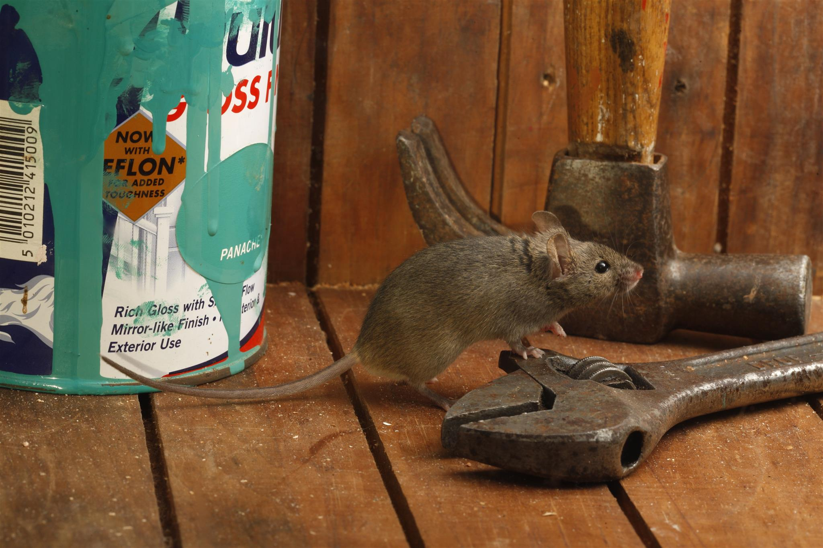
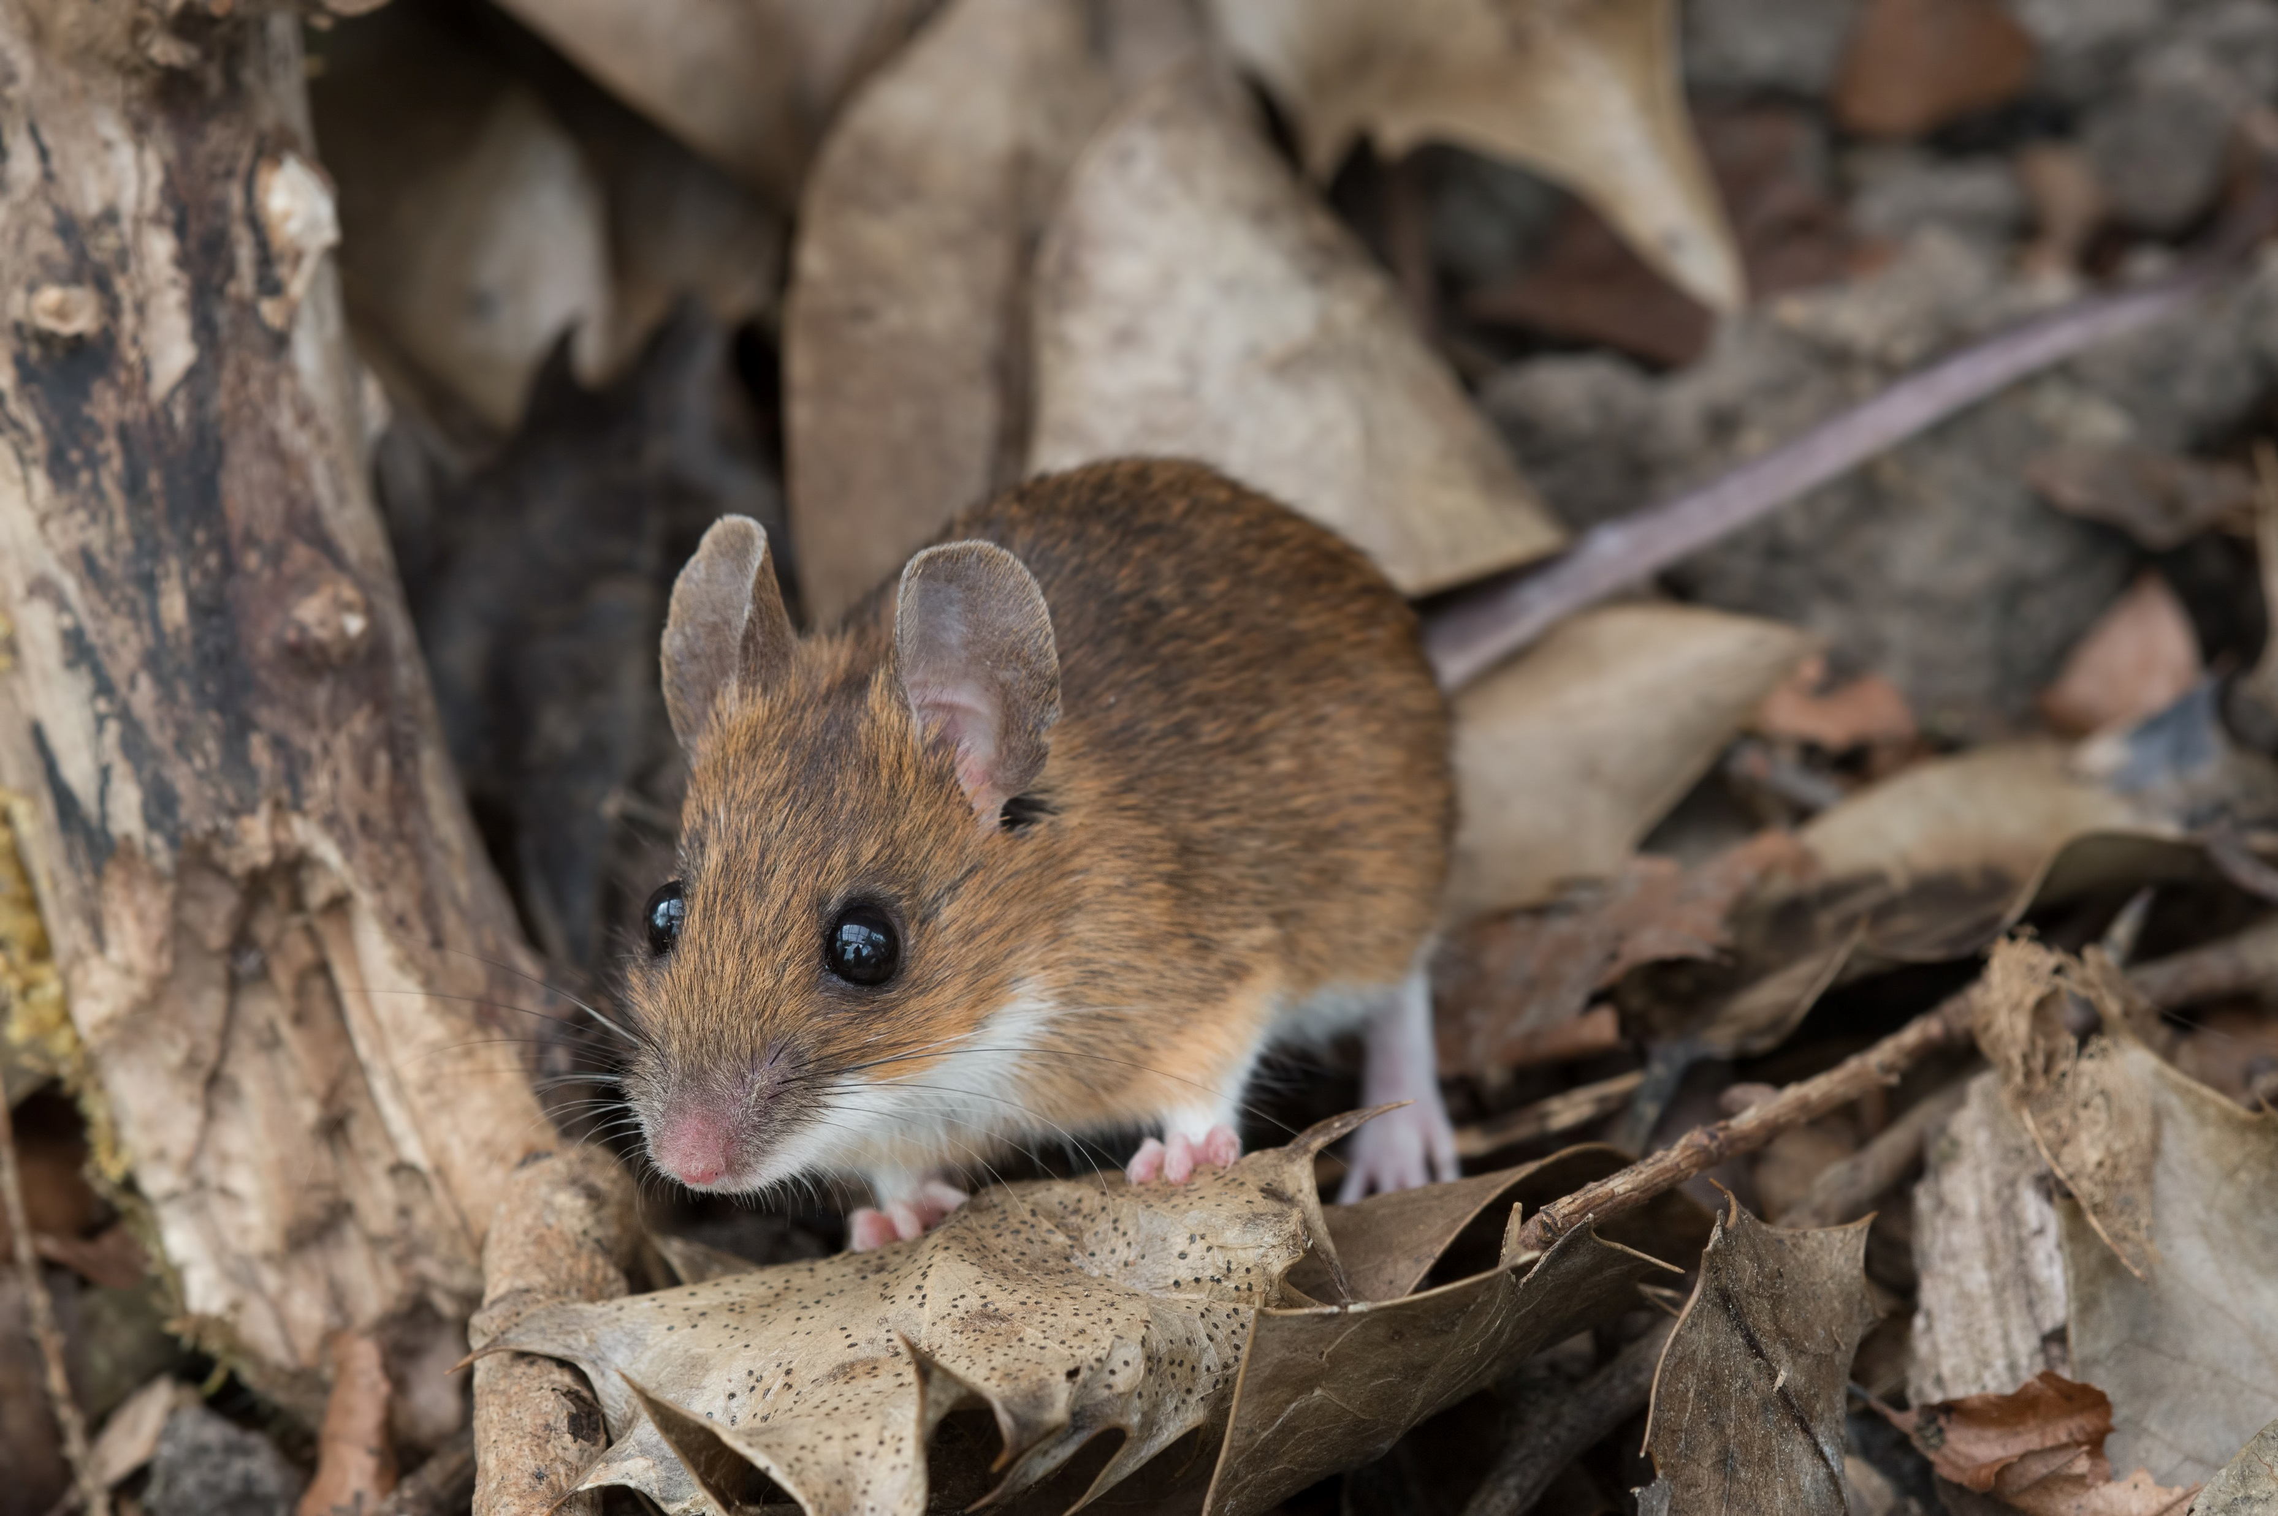
Which Species of Rodent?
House mouse – a major pest, lives almost exclusively indoors
Wood mouse (Long-tailed field mouse) – lives almost exclusively outdoors but is sometimes a pest – considered an important route of AVK contamination of the environment
Notes:
Some users will simply not be aware of the differences between these species, in what they look like or their very different behaviours.
Point out the ‘long white socks’ on the back legs of the Wood Mouse, as well as the two tone colouring.
The grey vs brown colouring may not be sufficient a difference, as there can be many colour variants of Mus musculus.
Image left: House mouse Mus domesticus
Image right: Wood mouse (field mouse) Apodemus sylvaticus

Slide 23
Which Species of Rodent?
professional users of AVK products should be able to tell rat activity from mouse activity
mouse activity external to a building is almost certainly going to be Wood mice and therefore should not be treated with AVK baits
mouse activity inside a building could be either House Mice or Wood mice
it is advisable to check first with traps, especially in suburban and rural areas and then treat accordingly
Notes:
Discuss the differences between rat and mouse ‘takes’ of bait. Asking the students to explain this may be useful, as no doubt some will have the experience to describe this.
If Apodemus are identified indoors, mouse traps should be used rather than any bait. This partly because it would be an illegal act, but also because Apodemus will not be indoors all the time and could become prey when foraging outdoors – contaminating the food chain if they have eaten baits.

Slide 24
Risk Hierarchy
explain why you intend to use anticoagulant rodenticides
  you must consider using other methods first, even if they, alone or in combination, won’t solve the problem
  the use of other methods – in conjunction with AVKs – will help to REDUCE THE RISKS that AVKs pose to the environment
AVKs are not a first option but are used only after consideration of the risk hierarchy and when a decision is reached that, either alone or in combination, alternatives will not achieve the required results
Notes:
The Risk Hierarchy is a key concept in the CRRU Code of Best Practice and this is an opportunity to discuss this in some detail to remind the students of this.
It is likely that the non-toxic methods alone will not solve a rat problem, but their use, alongside a baiting programme in an ‘Integrated Pest Management’ system will help to reduce reliance on AVK baits

Slide 25
Risk Hierarchy
record the non-toxic methods that you will use in conjunction with AVKs
  improving house keeping and hygiene
  removing harbourage
  proofing
  trapping
where these may not be possible or appropriate at this site, document the reasons

Slide 26
Risk Hierarchy
explain why you cannot use other toxic methods at this site, if that is the case e.g.
    alphachloralose
    phosphine gas
explain why you cannot use first generation anticoagulants at this site (resistance status?)
in short JUSTIFY, in writing, when you decide to use second-generation anticoagulant rodenticides
Notes:
Alphachloralose is only approved for use indoors, against mice, so is no use against rats.
Phosphine gas can only be used in very specific situations, far away from buildings and water courses, by specially trained and certificated users, using specialist equipment. In some circumstances, however, it can be very useful. The landowner may need to consider getting in a suitable specialist to carry out a fumigation, rather than use AVKs.
First generation AVKs can be used, very successfully, in many parts of the country. They should only be dismissed if resistance to AVKs is suspected or better, confirmed, in the local rat population.
The presence of resistance can be checked for by following a simple on-line questionnaire here: http://www.rrac.info/
Alternatively, samples of rat tails can be sent for DNA testing at Reading University. Presenters should make themselves familiar with the procedures for sending samples.

Slide 27
Significant Risk to Human or Animal Health?
this is the key justification for the use of AVK baits
if there is no significant risk to humans or animals from a rodent infestation, you should not propose their use
make sure that this justification is documented in your site survey and ERA
if no significant risk – think again

Slide 28
Long-Term Baiting
‘long-term baiting’ used to be standard practice
the RISK of AVK contamination of the environment is VERY HIGH if this approach is used, especially outside buildings, in suburban and rural situations
can you really justify its use?
can you do so and still comply with the label instructions of the product you intend to use?
Notes:
Reference should be made here to the CRRU Guidance on Permanent baiting document and presenters should be familiar with its contents.
Virtually all rodenticide products are labelled with instructions that are incompatible with ‘permanent baiting’.
Some products are expected to make reference to permanent baiting, as an acceptable technique, in specific circumstances. Presenters should confirm with suppliers which products these are, when they become available.

Slide 29
Long-Term Baiting
this technique used to be the norm and caused some part the environmental contamination with AVKs that we see today
it must now be a technique that is only used in exceptional circumstances
you must be aware of and follow the CRRU Guidance on Permanent Baiting
you must be aware of and follow the instructions on the label of the products you intend to use

Slide 30
Sensitive Areas
are there any protected species on the site?
  i.e. predatory birds, water voles, bats, dormice
are there any species of high conservation value on the site
  barn owls, red kites, peregrine falcons, otters
does the site fall within any protected areas?
  Nature Reserves, Special Conservation or Protection Areas, Sites of Special Scientific Interest
Notes:
Information on local situations can be found from Local Wildlife Trusts. Refer to the ERA Guidance Notes for further information.

Slide 31
Products
be precise about the products you intend to use
  product names
  active ingredients and concentration
  authorisation numbers
know exactly where they can be used
know exactly how they can be used
know exactly which species they are Approved for Use against

Slide 32
The ERA
remember, this ERA may be your ‘due diligence defence’ in a Court of Law
make sure that it is as thorough as possible
show that you have taken ‘all reasonable precautions’ to prevent contamination of the environment with the AVKs that you have used

Slide 33
The ERA
record all the known and likely ‘at risk’ animals on this site
record all the risk mitigation measures you will undertake to reduce the risks that will be posed by your introduction of AVKs to the site, including:
  integration with non-toxic measures
  use of alternative toxic products
  reduction in time that AVKs are used
  restricting access of AVKs to non-targets
  restricting use of AVKs to critical areas
  site visit frequency

Slide 34
Disposal of Rodent Carcases
a critical part of a rodent treatment, especially for the control of rats, is the search for and disposal of carcases
product labels require this to be done ‘at frequent intervals at least as often as baits are inspected or replaced’
this may be daily in heavy infestations
if you aren’t able to do this, you may ask someone else to do it – specify whom, and ensure that are competent and have suitable personal protective clothing

Slide 35
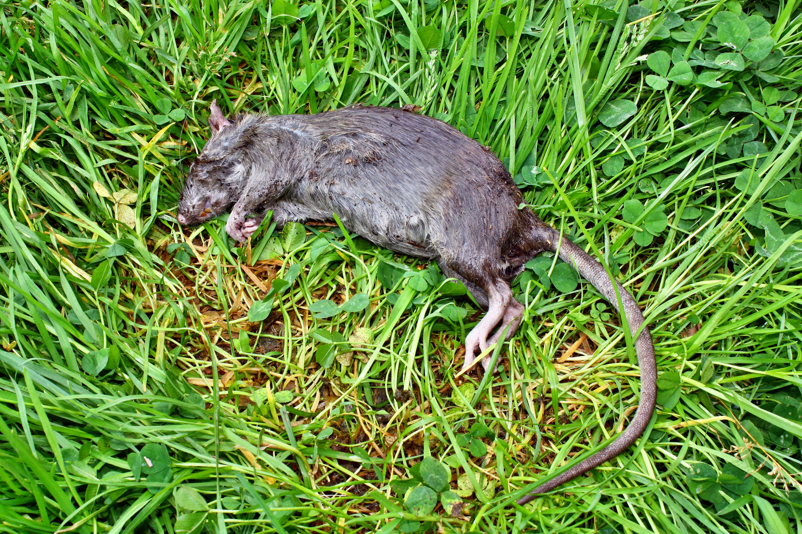
Disposal of Rodent Carcases
dependent on relevant factors:
  on farm – via small carcass incinerator
  on domestic premises – via domestic waste collection
  disposal off-site at authorised incinerator or via licenced waste disposal company to landfill
  disposal on-site, in line with requirements of relevant Government agencies
Notes:
Image: Rat carcass Rattus norvegicus

Slide 36
Disposal of Spent Bait
‘spent bait’ can be recycled, re-used at other sites, provided it is in a reasonable condition
if it cannot be re-used, it becomes ‘Hazardous Waste’ and can only be moved off-site under a Consignment Note with the EWC number 20 01 19*, by someone registered as a Licenced Waste Carrier
it must be disposed of by a Licenced Waste Disposal contractor

Slide 37
Conclusion
‘can this treatment safely proceed’
decision time
given the information recorded in the ERA, you must then decide if the use of AVKs can be justified, or not
it is a balancing act between protecting human and animal health vs protecting the environment
only you can make that decision

Slide 38
SUMMARY
AVKs present a significant potential HAZARD to the Environment in most use scenarios
every time you introduce them to a site you are posing a POTENTIAL RISK to the local environment
you must consider what ‘non-target’ birds and animals might be at risk from your actions
you must consider how you can reduce this risk and introduce all available and appropriate risk mitigation measures into your treatment
the ERA helps you do this, shows it has been done and provides you with a ‘due diligence defence’, if ever needed

