Slide 1
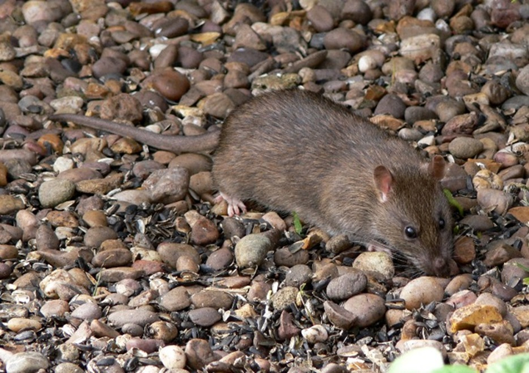

Resistance to anticoagulant rodenticides in rats and mice
CRRU UK
A training resource for:
Continuing Professional Development

Slide 2
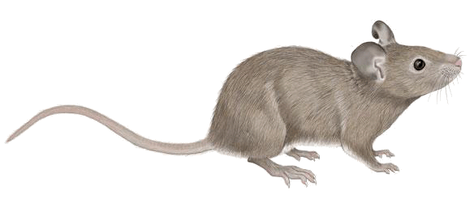
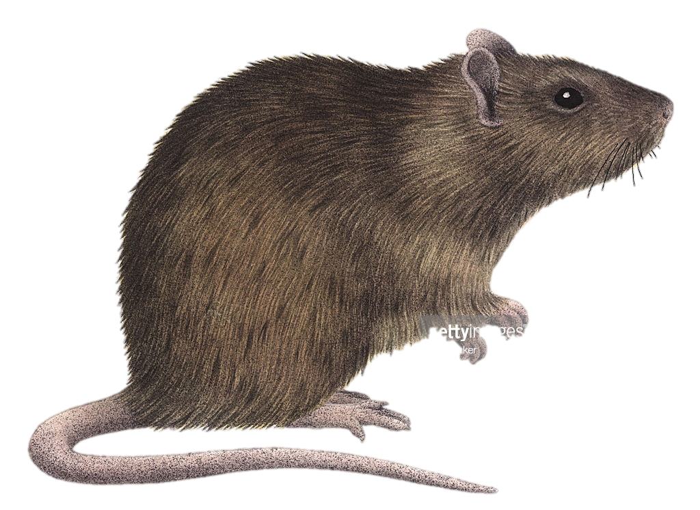
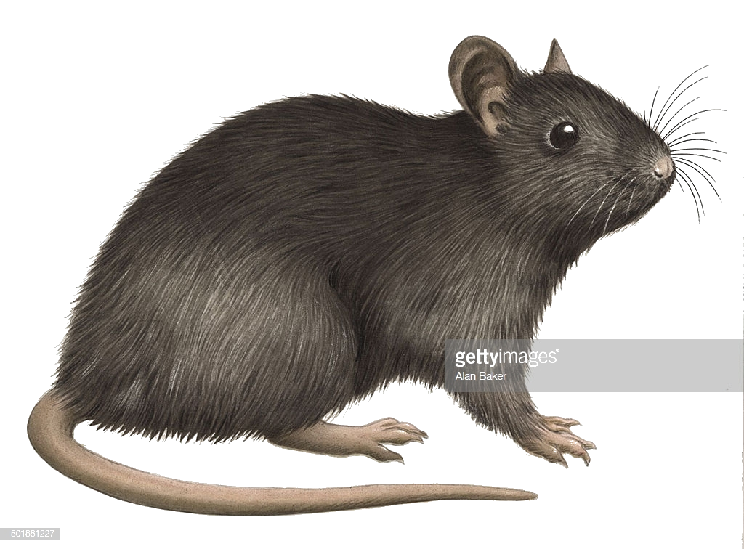
Rodent Pests with Resistance
Norway rats
House mice
Black rats
Notes:
Resistance to anticoagulants has been found in three major commensal species, the house mouse, Norway rat and the black rat. I won’t be talking about the black rat because its not particularly relevant to us in the UK and far less in known about its resistance. The house mouse and brown rat are by far the most dominant rodent pest in the UK and seem to have the largest known case of resistance

Slide 3
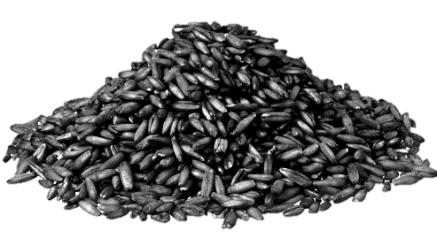
Before Anticoagulants
Prior to 1950:
All rodenticides were single dose fast acting compounds (ACUTE)
    No longer used: Zinc phosphide, Fluoroacetamide
    Still used today: Alphachloralose Calciferol
Notes:
Considering these species have been a major pest for hundreds of years anticoagulants have only been around for a relatively short time. Before 1950 anticoagulant rodenticides weren’t available, instead acute rodenticides such as zinc phosphide were the main chemicals used for rodent control. And indeed some acute rodenticides such as alphachloralose are still used today.

Slide 4
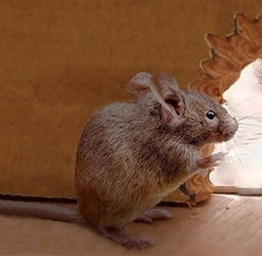
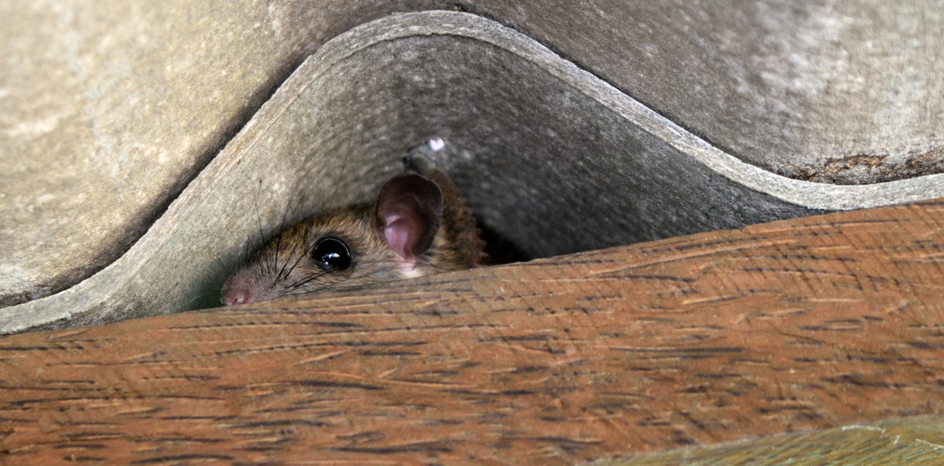
Acute Rodenticides
  Acute mode of action
    rodents feed once and death occurs quickly
Key Disadvantage: BAIT SHYNESS
Notes:
So there's no known resistance to acute rodenticides so why don’t we just stick with them? Well these compounds have one major drawback. They work too quickly! Because rodents tend to consume only a small amount of a new food they can associate illness with a recently consumed food item. And because acutes are so potent they start to make the rodent feel ill within only a few hours. If that animal then goes onto survive that initial dose they’ll learn to avoid that food type. Which is what we call bait shyness. This is why it is harder to achieve 100% control with acute rodenticides

Slide 5
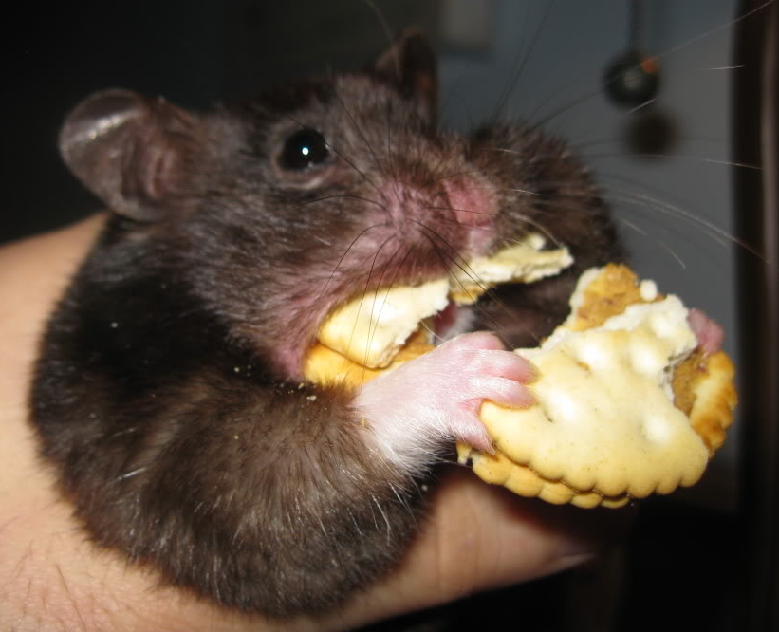
Anticoagulant Rodenticides
  Discovered in 1930s
  Warfarin & Coumatetralyl were introduced 1950s
  Now referred to as first generation anticoagulants – FGARS
Key Advantage: NO BAIT SHYNESS
Notes:
Then about 70 years ago anticoagulants came onto the market... Actually discovered in 1930s on a farm where many cattle were mysteriously dying from haemorrhages. It was because of a chemical contaminant in the hay that was preventing the cattle's blood from clotting. And From this contaminant, synthetic derivatives like warfarin were made
The major advantage of anticoagulants is that they have a chronic mode of action so it can take several days or more to kill the animal, thus allowing the rodent to feed repeatedly on the bait before experiencing any symptoms.
So that’s why anticoagulants have been so successful and why they are still the dominate chemical control method used today.

Slide 6
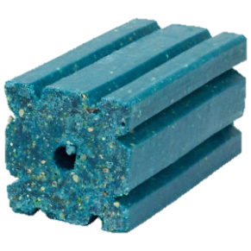
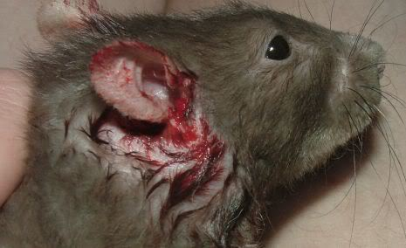
How do they work?
Vitamin K cycle
Anticoagulants block the:
Blood Can’t Clot
Vitamin K
Animal haemorrhages
Notes:
The exact mechanism by which anticoagulants work is still a grey area but essentially all anticoagulants work in the same way by blocking the Vitamin K cycle which inhibits blood clotting and leads to haemorrhages.
Anticoagulant molecules can outcompete vitamin k molecules which stops the vitamin k cycle from producing blood clotting factors.
This is why the antidote to anticoagulant poisoning is vitamin K1 and also why resistant animals tend to have a higher requirement for vitamin k in their diet.

Slide 7
Genetic Resistance
Genetic studies indicate that resistance is caused by a single gene mutation:
  VKORC1
  gene mutation
  Changes enzyme’s shape in the vitamin K cycle
  Blocks anticoagulant molecules
Notes:
It is known that a single gene is responsible for widespread resistance to anticoagulants (its called the VKORC1).
Mutations within this gene, which can be passed onto the next generation, change the structure of the enzymes in the vitamin k cycle so that they block anticoagulant molecules from binding. In this way the vitamin k cycle can continue without interference and blood can clot as normal in resistant animals.

Slide 8
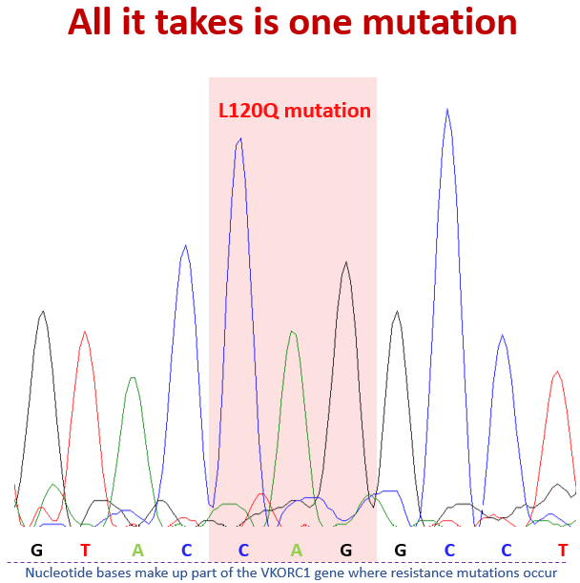
  VKORC1 gene
Graph shows genetic mutation in a rat
It only takes one nucleotide base to mutate/change
Nucleotide bases
L120Q “Berkshire” resistance
Notes:
This graph shows part of the genetic sequence of a Norway rat’s VKORC1 “resistance” gene. The letters refer to nucleotide bases,
it only takes one of these bases to mutate/change to result in a resistant animal! This individual has the L120Q “Berkshire” resistance.
The genetic code in the resistant rat is CAG, whereas in a normal susceptible rat it would be CTG

Slide 9
Cross Resistance
  All anticoagulants are similar in structure
  An animal with warfarin resistance will also have some resistance to similar anticoagulants like chlorophacinone and coumatetralyl
But resistance severity won’t be exactly the same
Resistance SEVERITY
A
B
C
Anticoagulant
Notes:
Because anticoagulants are all similar in structure this means that resistance to one compound also means there will be at least some resistance to other anticoagulant compounds. Therefore where warfarin resistance develops there is also cross resistance to other anticoagulants (e.g. chlorophacinone, coumatetralyl)
However, the level of resistance will be different for each anticoagulant. There could be high resistance against one compound and low resistance against another or they could be very similar.

Slide 10
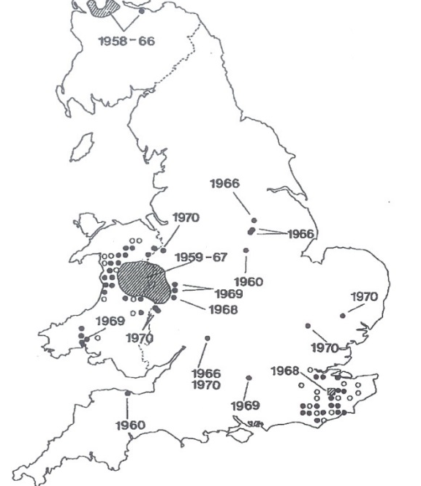
First wave of resistance
  Since 1958 resistance to first generation anticoagulants has been detected in:
  Britain
  Denmark
  The Netherlands
  France
  Germany
  Japan
  USA
  Brazil
UK Outbreaks and surveys 1960s and 1970s
Notes:
Resistance to first generation anticoagulants (Warfarin & Coumatetralyl etc.) was first found in Scotland in late 1950s ( )
and then spread seemingly rapidly throughout the UK & many other countries worldwide in 1960s-70s.
This could have been in partly due to our transportation routes, ferrying resistant rats across the globe. However, the fast emergence of resistance in rodents indicates that resistant mutations were present in populations well before anticoagulants were introduced and the large use of these compounds has selected these mutations and increased their prevalence.

Slide 11
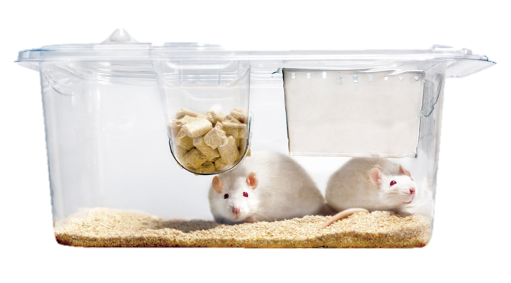




Identification of resistance
  Feeding Tests (1960s to 1980s)
  Limitation: Can’t determine specific mutation
  Field Evaluations (1960s to date)
  Limitation: Can’t determine specific mutation
  Blood-Clotting Response Tests (1970s to date)
  Limitation: Can’t determine exact survivability
  DNA Sequencing (2005 to date)
  Limitation: Can’t determine resistance severity
Notes:
When resistance first emerged there were actually only a couple of ways to identify it. These were feeding tests with caged animals and field trials.
There are now 4 different ways of identifying resistance. But each technique alone can’t tell you the whole story, so in an ideal world all 4 techniques would be used to determine a population’s resistance status.
With Feeding tests & Field trials: you feed bait to caged or wild rodents and If the rodents eat large amounts of bait but survive then there is likely to be a resistance problem
However, these tests alone can’t tell you which type of resistance is present
A more modern technique is the Blood-clotting response test: this is where you dose the animal with an anticoagulant and measure how long it takes for its blood to clot when stimulated. A resistant animal’s blood will clot quite quickly similar to a normal animal. So if you measure this clotting time you can tell which individuals carry resistance and what level of resistance they have. So the longer it takes for that animals blood to clot the less resistant they are
However, only a feeding test can determine if the resistance severity results in survival after bait consumption.
DNA: The most recent method is DNA sequencing. This can identify if the animal has a resistant mutation and what mutation is it.
However, DNA tests alone can’t tell us the severity of the resistance to different compounds

Slide 12
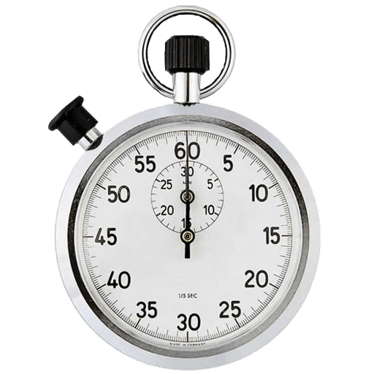
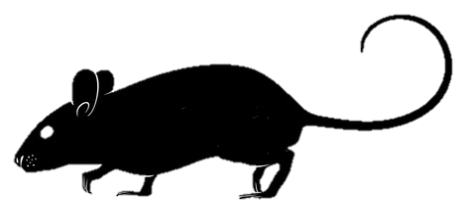

Blood Clotting Response (BCR)
Dose the animal
Take blood
Measure coagulation time
Coagulation time
Control
Normal
Resistant
Notes:
Dose the animal with an anticoagulant, take its blood and measure the coagulation time.
A resistant animal’s blood will clot quite quickly, similar to a normal animal. So if you measure this clotting time you can tell which individuals carry resistance and what level of resistance they have. The longer the coagulation time the less resistant the animal

Slide 13
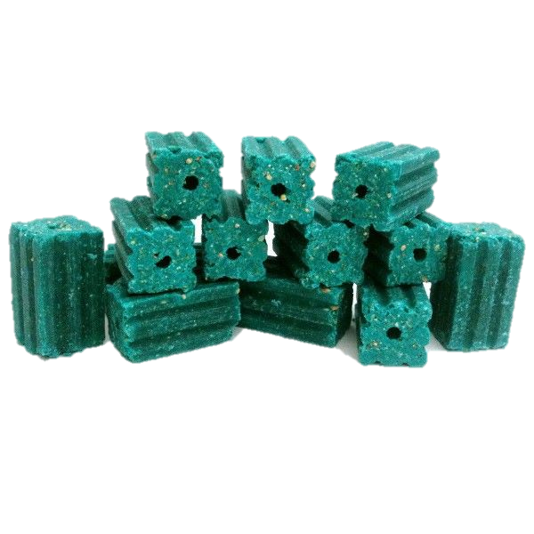
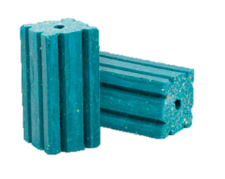
RESISTANCE SEVERITY
  Trying to measure resistance levels is difficult
  One way is to calculate RESISTANCE FACTORS
Resistance factor of 2 = twice the dose to kill
Resistance factor of 10 = ten times the dose to kill
Resistance factor of 100 = one hundred times the dose to kill
Notes:
From blood clotting tests you can actually calculate what’s called a resistant factor.
The ‘resistance factor’ determines the amount of anticoagulant required to kill the target animal based on a normal lethal dose
So if an animal had a resistant factor of 2 it would have to consume twice the amount of a normal lethal dose to result in death

Slide 14
Calculating Resistance Factors
Responder
Coagulation time
Non-responder
Notes:
Resistance factors are calculated from the number of “responders” in a group of animals
The responders are those animals that have long coagulation times i.e. they responded to the anticoagulant.

Slide 15
Calculating Resistance Factors
Effective dose of resistant animals
=
Resistance factor
Effective dose of susceptible animals
e.g. Male L120Q resistant rats vs Male susceptible rats
ED50 = 0.790
=
3.6
ED50 = 0.217
So it would take 3.6 times the amount of anticoagulant to kill 50% of male L120Q rats compared to 50% male susceptible rats
Notes:
You must repeat BCR tests at different doses and record the number of responders
Probit analysis can then tell you the effective dose i.e the dose at which animals respond at a particular dose
So an ED50 would be the dose at which 50% of animals were responders
The difference between the ED of resistant and susceptible animals determines the resistance factor
Example…
So it would take 3.6 times the amount of anticoagulant to kill 50% of male L120Q rats compared to 50% male susceptible rats

Slide 16
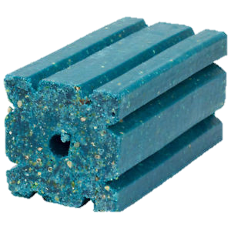
Resistance Definitions
  TECHNICAL RESISTANCE
    The resistance has no observable practical effect
    e.g. resistance factors less than 5
  PRACTICAL RESISTANCE
    The resistance has a practical effect on control
    e.g. resistance factors greater than 10
Notes:
How resistance effects control efficacy can be split into two categories:
Technical resistance - where resistance tests identify resistance but where resistance level is low and there is no observable practical effect on control
factors less than 5 are unlikely to have a significant negative effect on practical efficacy
Practical resistance - where resistance is identified and resistance is sufficiently high so that an acceptable level of control is unlikely to be achieved
factors greater than 10 are likely to have a significant detrimental effect on efficacy
So in one study it was found that Welsh female rats had a warfarin resistance factor of = 2296

Slide 17

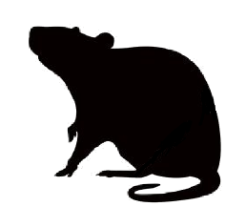



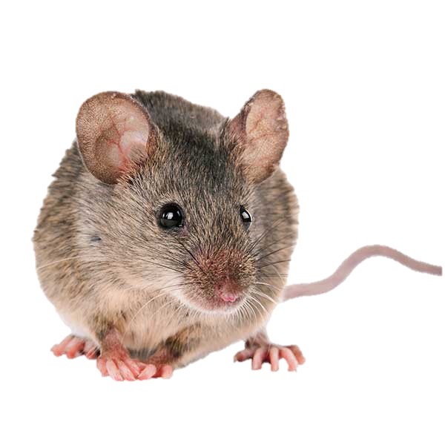
Resistance Variations
  Level of resistance is dependent on several factors such as:
STRAIN
GENOTYPE
L120Q
SEX
NATURAL TOLERANCE
Notes:
Just to make things even more complicated, the level of resistance in an animal is affected by many factors such as
Strain
e.g. L120Q mutation has the highest recorded levels of resistance known
Genotype
Heterozygous rodents have far lower resistance than homozygous rodents
Sex
Females tend to have higher levels of resistance than males
Natural Tolerance
Natural tolerance to anticoagulants is known, particularly in mice

Slide 18
Homozygous & Heterozygous resistance
A resistance strain exists in two forms:
Heterozygous & Homozygous
1 copy of the resistance mutation
Lower level of resistance
Can produce susceptible offspring
2 copies of the resistant mutation
Highest level of resistance
All offspring are resistant
Notes:
An individual has two copies of an allele in a gene, one from the mother and one from the father.
A fully susceptible animal has two copies of the susceptible/normal allele.
So a resistant animal can exist in two forms – heterozygous and homozygous
A heterozygous animal has one copy of the resistance allele and one normal allele.
Whereas A homozygous animal has two copies of the resistance allele.
This is the most severe form because these animals have a much higher tolerance to anticoagulants and will always produce resistant offspring.
This is the kind of information we can get from DNA analysis.

Slide 19
In Response to Resistance
The development of new anticoagulants
(the Second Generation Anticoagulants “SGARS”)
        Difenacoum (1975)
        Bromadiolone (1976)
        Brodifacoum (1979)
        Flocoumafen (1984)
        Difethialone (1986)
  ONLY LOW TECHNICAL RESISTANCE
Notes:
So what happened after the first wave of resistance hit?
Well new anticoagulants were developed. These were named the “second generation anticoagulants”
Because of this cross resistance issue resistant animals were also resistant to these new second generation anticoagulants.
HOWEVER it was only found to be at low levels. (Only low technical resistance was found for these compounds rather than practical resistance)
So when bromadiolone and difenacoum were first marketed they worked well really well

Slide 20
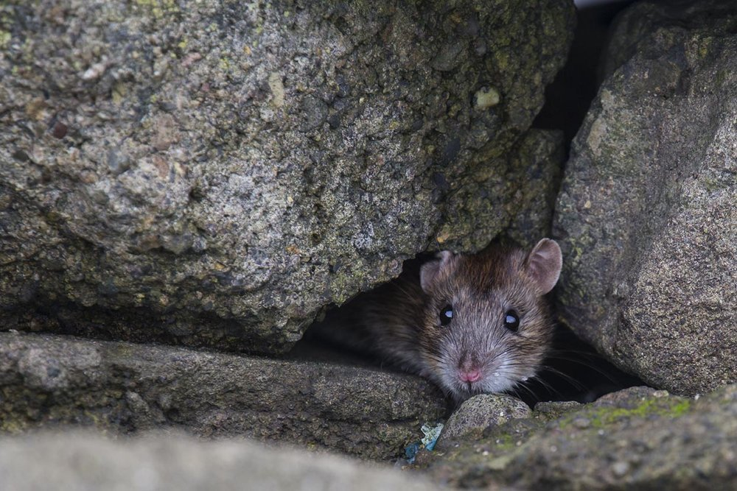
Low level resistance didn’t last long…
  1991 Berkshire:
  Two 50ppm bromadiolone treatments FAILED
  ● 248kg - 585kg of rodenticide used
  ● High resistance factors found (18 – 30)
  (see Quy et al, 1995)
Notes:
However this didn’t last long. In 1991 two bromadiolone field trials in Berkshire completely failed to control large rat infestations.
5 rats were trapped from these farms for Laboratory Studies
ALL 5 of these rats SURVIVED eating 100ppm bromadiolone for 6 days!
All 5 of these rats were found to have high resistance factors (18 – 30)

Slide 21


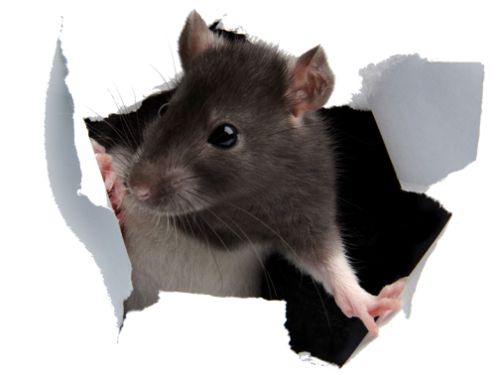

“Berkshire” Resistance
L120Q
Notes:
With the use of modern molecular techniques we now know the resistant rats in Berkshire turned out to have the L120Q mutation, aptly called the Berkshire resistance.
But this isn’t the only mutation we have found….

Slide 22
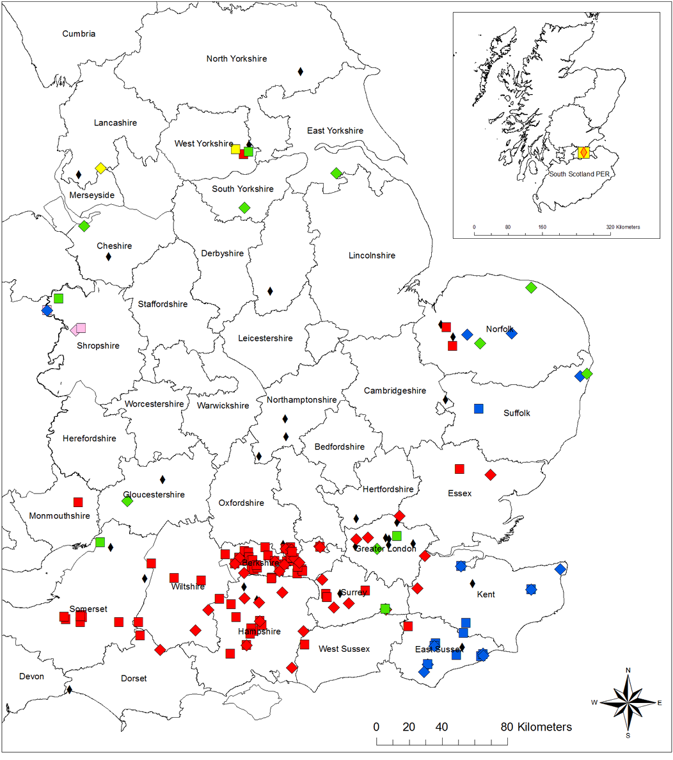
Norway rat VKORC1 mutations identified to date in the UK
5 MUTATIONS
L128Q
Y139S
L120Q
Y139C
Y139F
Most severe and abundant
Notes:
This is a map of resistant and susceptible rats we have found within Britain so far.
We have found a whopping 5 different mutations, 3 of which are also found in abundance in neighbouring countries and which have the highest levels of resistance known
The mutations were identified by DNA analysis of rat tail clippings, so each coloured dot you see is a resistant rat mostly sampled from farms
From the map you can see that the red mutation dominates the south of England and there's also a distinct blue area in Kent and east Sussex
But as you move north there seems to be more of a mixture of mutations. The counties of Norfolk, Shropshire and West Yorkshire all have 3 different mutations
Many of the points are biased towards the Reading/Berkshire area because of the close proximity to the Reading labs where DNA analysis took place.
This means that many more locations around the UK could have resistant populations.
We have little or no data from counties in the Midlands, Devon & Cornwall & Wales and Scotland ( )
The RRAG recommendation is that bromadiolone and difenacoum should not be used against infestations that possess the three most severe mutations: L120Q Y139C & Y139F (red, green, blue)
The fast emergence of resistance in rodents indicates that these mutations were present in populations well before anticoagulants were introduced and the large use of these compounds has selected these mutations and increased their prevalence. Not only that but continued use of antis can selected for the most severe forms of resistance. This could be why resistance has been found at a lower frequency in black rats compared to Norway rats because black rats are less exposed to anticoagulants.

Slide 23
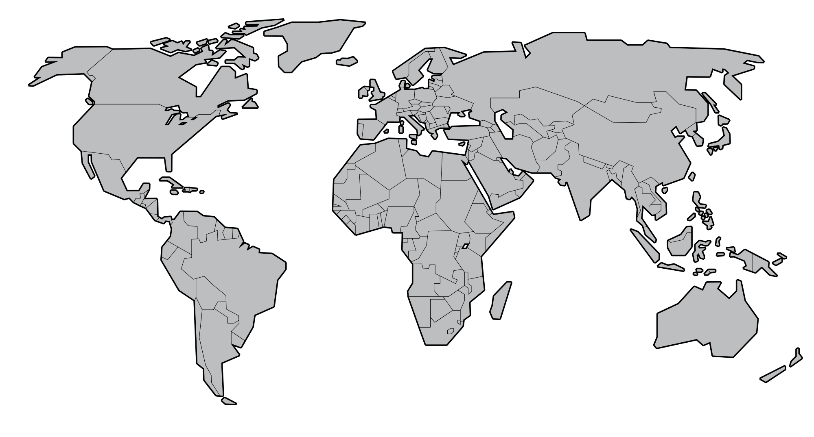
Europe Rat Mutations – RESISTANT COUNTRIES
Britain (5)
France (4)
Belgium (3)
Netherlands (2)
Denmark (1)
Germany (1)
Hungary (1)
Notes:
So we are actually the only place in the world with all 5 of these mutations
France comes in next with 4, Belgium 3, Netherlands 2 and 3 others with just 1
United Kingdom 5 mutations known to negatively impact control using anticoagulants
France 3 most severe and L128Q (mostly Y139F)
Belgium 3 most severe
Netherlands Y139C & Y139F
Denmark Y139C only
Germany Y139C only
Hungary Y139C only
Ireland No resistance found
Azores No resistance found
Italy No resistance found
Spain No resistance found (little data)
Yemen No resistance found (little data)
Tanzania No resistance found (little data)
Thailand No resistance found (little data)
Tunesia No resistance found (little data)
Pakistan No resistance found (little data)
San Marino No resistance found
South Africa no resistance found (very little data)
Lebanon No resistance found (little data)
Mozambique No resistance found (little data)
Iraq no resistance found (little data)
Israel no resistance found (little data)
United States of America (few places found to have R35P)

Slide 24
Europe Rat Mutations – NO RESISTANCE FOUND
Ireland
Italy
Spain
Azores
Notes:
But Strangely some countries where you would also expect there to be resistance, no resistance has been found
Ireland No resistance found
Azores No resistance found
Italy No resistance found
Spain No resistance found (little data)
Yemen No resistance found (little data)
Tanzania No resistance found (little data)
Thailand No resistance found (little data)
Tunesia No resistance found (little data)
Pakistan No resistance found (little data)
San Marino No resistance found
South Africa no resistance found (very little data)
Lebanon No resistance found (little data)
Mozambique No resistance found (little data)
Iraq no resistance found (little data)
Israel no resistance found (little data)
United States of America (few places found to have R35P)

Slide 25
Global Rat Mutations – NO RESISTANCE FOUND
Yemen
Tanzania
Thailand
Tunisia
Pakistan
San Marino
South Africa
Lebanon
Mozambique
Iraq
Israel
Notes:
And in fact there are many other places all over the world where no resistance has been found (although most of these have very little samples sizes)
So when it comes to our rats we are quite unique
United States of America (few places found to have R35P)

Slide 26
RRAG RECOMMENDATIONS
Not recommended
Some evidence to suggest control efficacy will be negatively effected
Recommended
Notes:
So what can we do about all of this resistance?
For guidance RRAG have produced a table showing the different anticoagulants and their known effectiveness against resistance
A red box means that the active substance should not be used against that strain and a green box means that it is likely to result in successful control.
The more tricky part is when it comes to using bromadiolone and difenacoum.
Resistance to these two compounds has probably been building up over the years because until recently those were the only two SGARs you could use outdoors, So they’ve been the anticoagulant of choice for decades. So what's probably happened is we’ve unintentionally been selecting for bromadiolone and difenacoum resistant rats
So the amber box means that there is some level of resistance but that at least some of a population may still be controlled with these compounds. However, these active substances are probably best avoided to prevent selecting for and spreading resistance (amber box).

Slide 27
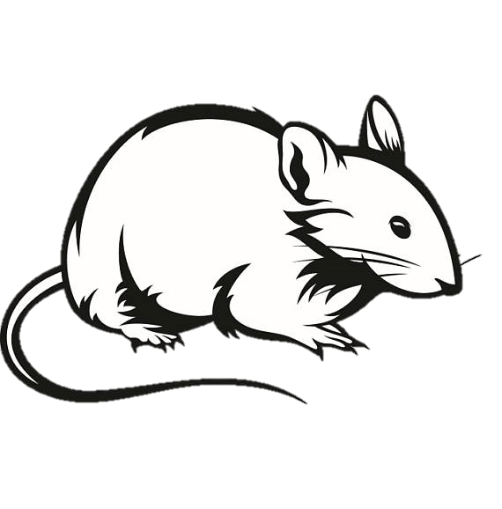
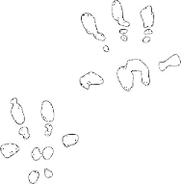
House mouse VKORC1 mutations
L128S Cambridge (1980s) | Y139C Reading (1970s) | L128S & Y139C
This strain is no longer held in any UK laboratories | Currently exists at Reading University for research purposes | Nothing is known about mice with both mutations
Notes:
For the house mouse, there are only two known resistant mutations in the UK – Y139C & L128S. Compared Norway rats, we known very little about the resistance strains for this species. What we do know is house mice possess a natural tolerance to anticoagulants and so a certain level of resilience to these poisons has been present since their introduction over half a century ago.
What seems to be more common in mice though are individuals carrying 2 resistant mutations. So we’ve found both mutations in the same animal

Slide 28
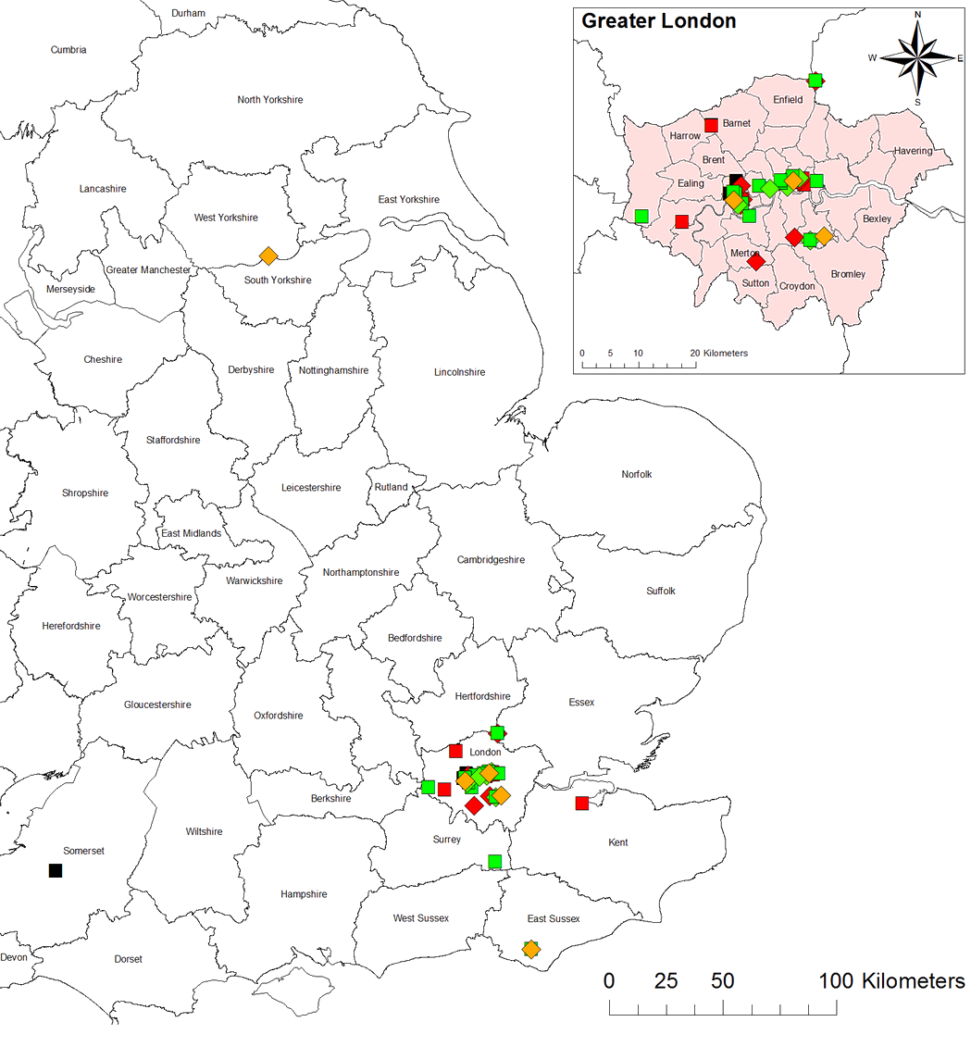
House mouse resistance in Britain
88% RESISTANT
(56% were homozygous resistant)
Notes:
Again we have produced a map of Britain showing where we have found these mutations
We have a much lower number of samples compared to Norway rats
But we’ve had a good number from London where 88% of the mice we sampled had atleast one resistance mutation
And over half of these were homozygous which suggests that ineffective poisons have been favouring resistant mice over many generations

Slide 29
Global Mouse Resistance
UK
France
Germany
Switzerland
Azores
Spain
Serbia
Singapore
USA
Notes:
And this is a similar frequency to mouse resistance found in Germany, Switzerland and Azores.
Also several other places around the world have found these two mouse mutations. So we are not so unique when it comes to our mice
United Kingdom Both
Azores Both 80%
France Both and spretus
Germany Both and spretus 80%
Switzerland Both and spretus 80%
Spain Only spretus (very little data)
Serbia Both (little data)
United States of America Both (most data from east)

Slide 30
Recommendations
Not recommended
Some evidence to suggest control efficacy will be negatively effected
Recommended
Active Substance | Resistance Mutation
 | L128S | Y139C
Warfarin etc.
Bromadiolone
Difenacoum
Brodifacoum
Difethialone
Flocoumafen
FGARS
SGARS
Notes:
So similarly to Norway rats it is widely accepted that FGARS should not be used against resistant mice
Again brodifacoum, dif, flo, are all recommended for control
But when it comes to bromadiolone and difenacoum, again, its not so clear cut.
We know that there is some practical resistance to both of these products because both strains of mice have been shown to survive both bromadiolone and difenacoum treatments.
But unfortunately because L128S mice are not held in any laboratories we known very little about the exact level of resistance it can carry against these two compounds, which is why I’ve given them an amber box
However we actually carry the Y139C strain of mouse at Reading University. And recently we were able to calculate resistance factors against all 5 SGARs.
And it turns out this mouse has high resistance factors against bromadiolone but low RFs against the rest including Difenacoum.
So this suggests that difenacoum should be efficacious against this strain of mouse.
However, these mice have been bred from mice caught in the wild in the 1970s. So this may just be a snapshot in time showing resistance levels 50 years ago. So it is quite possible that we now have mice with much higher resistance levels, which is only going to make controlling them harder.

Slide 31
Options for control
Non-anticoagulant (acute poisons, traps etc.) | Bait shyness, Neophobic
Notes:
So when it comes to controlling an infestation where resistance is unknown, what are your options?
Well one way to avoid dealing with the resistance problem is simply not use an anticoagulant
However, the drawbacks with these methods are bait shyness and neophobic behaviours

Slide 32
Options for control
Non-anticoagulant (acute poisons, traps etc.) | Bait shyness, Neophobic
Pick any anticoagulant | Wasteful Make problem worse
Notes:
Or you could just pick an anticoagulant that you’ve been using for ages
But if you do come across a significant resistance problem you could not only waste bait but you could also end up selecting for resistant animals and making the problem worse

Slide 33
Options for control
Non-anticoagulant (acute poisons, traps etc.) | Bait shyness, Neophobic
Pick any anticoagulant | Wasteful Make problem worse
Check for resistance first (RRAC, Tail testing) | Increase likelihood of efficacy
Notes:
Or you could try and check if your area or site has a resistance problem before you decide on an anticoagulant
There are two ways you can do this

Slide 34
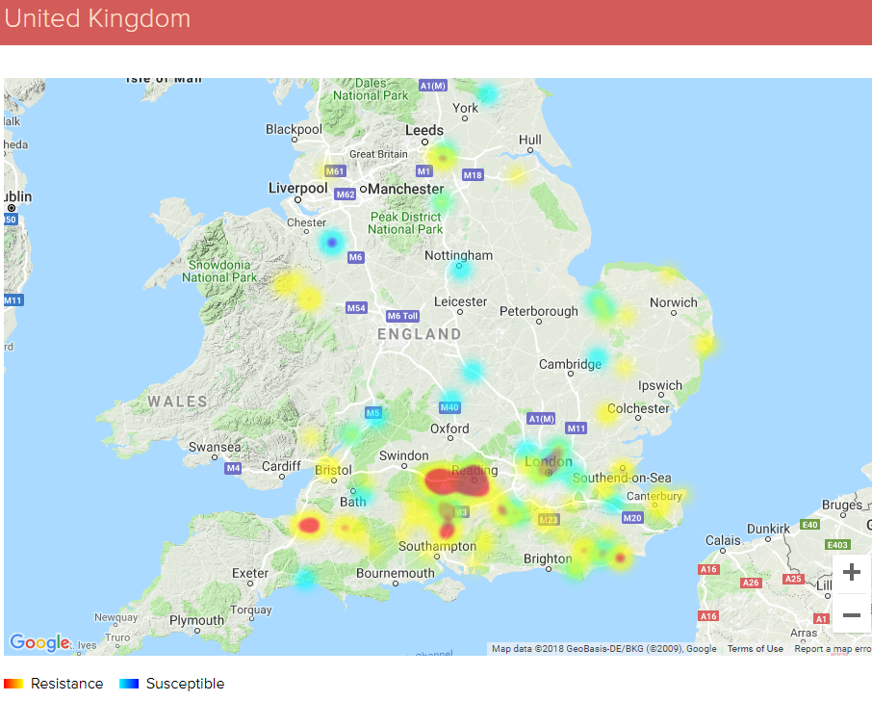
RRAC Resistance maps
(Norway rat shown)
http://guide.rrac.info/resistance-maps
Notes:
There are interactive maps and questionnaires on the RRAC website which are designed to tell you which areas are known to have a resistance problem and what anticoagulants to avoid using

Slide 35




FREE RAT & MOUSE RESISTANCE TESTING
NOT AN OPPORTUNITY TO BE MISSED!
Free resistance screening of rat and mouse-tail clippings.
1.
2.
3.
Name
Email
Site Postcode
CUT
2-3cm tail tip
BAG
In a sealable bag
POST
Within 24hours
Notes:
And if you want more precise resistance information RRAC are also funding work through us at Reading University
You can now discover the resistance status of rats and mice for free if you send in a couple of tail tips for genetic analysis.
We can then tell you if those animals have any resistance, what strain it is and what compounds to avoid using

Slide 36

Research facility at Reading University
Contact the Vertebrate Pests Unit at Reading University to ask about sending in tail samples for screening
  Email the research officer for more information (clare.jones@reading.ac.uk)
  Also visit the webpage where you can download the protocol & look at the resistance MAPS
https://research.reading.ac.uk/resistant-rats/
Notes:
If you are interested contact through the Reading email & look at our webpage

Slide 37
Summary recommendations
Widespread resistance in brown rats to bromadiolone and difenacoum in the central south of England
Bromadiolone not recommended for house mice
Difenacoum not recommended for house mice in areas of resistance
Avoid using resisted products in areas of resistance
Use more potent anticoagulants were appropriate
E.g. brodifacoum, flocoumafen, difethialone
Also consider non-anticoagulant options
Remember the importance of integrated pest management: proofing, hygiene, trapping
Utilise the rat and mouse resistance testing facility at the University of Reading

Slide 38
Reading List
Anticoagulant Resistance in Rats and Mice in the UK – Current Status in 2018
https://www.thinkwildlife.org/downloads/
House mouse & Norway rat resistance guidelines
https://bpca.org.uk/about/partners/rrag
Vertebrate Pests Unit’s rodenticide resistance webpage:
  Download the sampling protocol
  Download information posters
  Take a look at the latest UK RESISTANCE MAPS
https://research.reading.ac.uk/resistant-rats/

